Slide 1
Simple Load Pull Report
None

Slide 2
Test Configuration
Frequencies: (GHz)
11.4, 11.3, 11.2, 11.1, 11, 10.9, 10.8, 10.7, 10.6, 10.5
Input Powers: (dBm)
6, 8, 10
Load Impedances:
Gamma Magnitude:
0.1, 0.2, 0.3, 0.4, 0.5
Gamma Phase
-175, -145, -115, -85, -55, -25, 5, 35, 65, 95, 125, 155
Comments
None
Data and Time: 2025-08-22_05_30

Slide 3
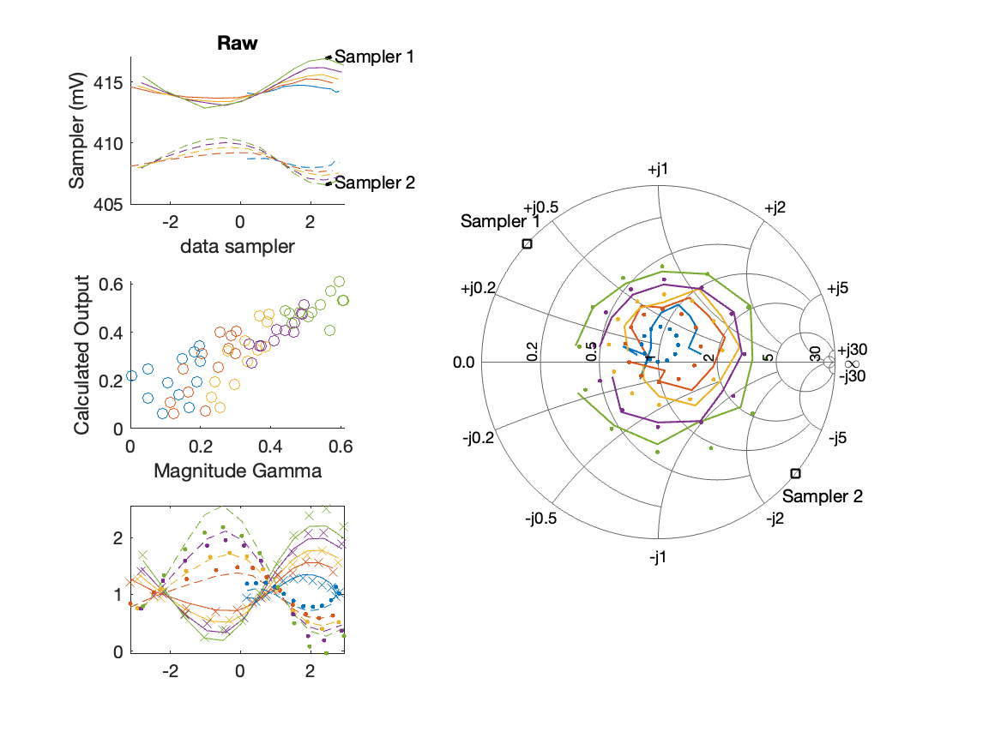
Sampler Performance Frequency 10.50 GHz, Power 6 dBm
Sampler Av
Sampler 1: 276.109
Sampler 2: 286.574
Sampler Offset (rather than -1)
-231.4077
Goodness Of fit
0.13417

Slide 4
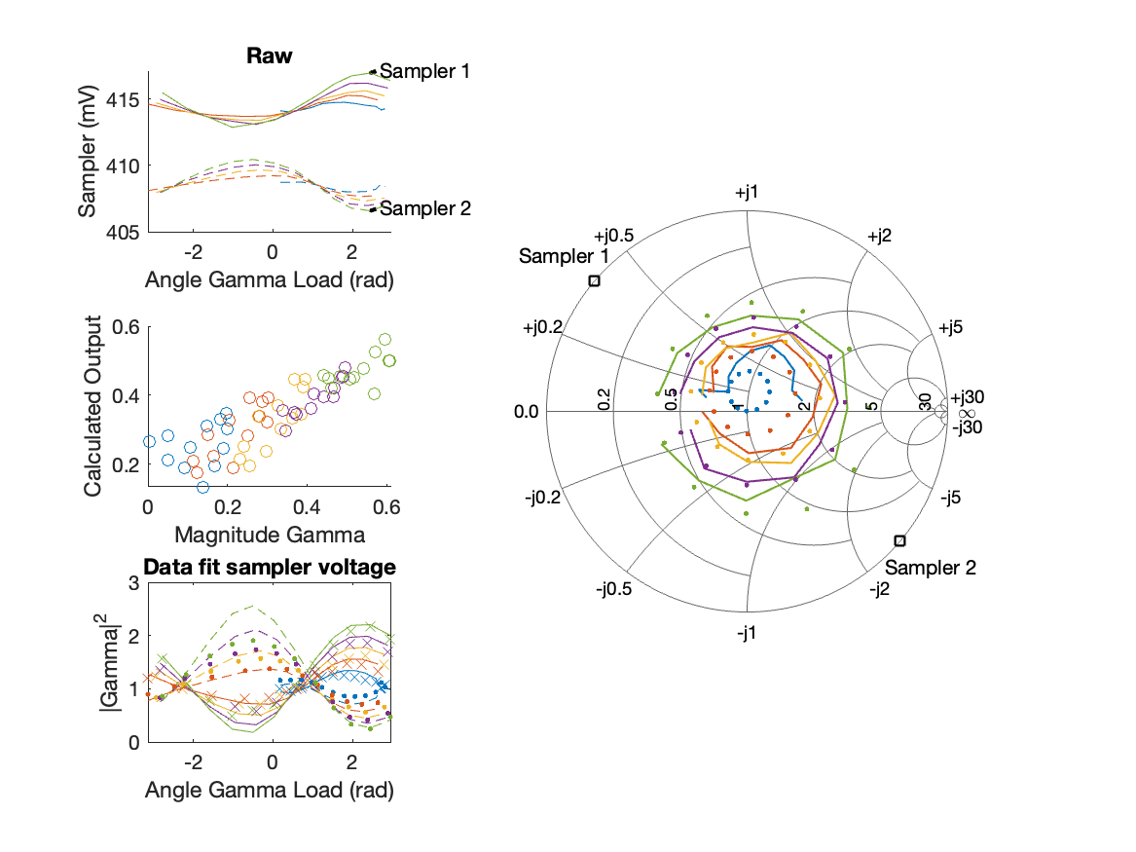
Sampler Performance x^3 Frequency 10.50 GHz, Power 6 dBm
Sampler Av
Sampler 1: 2.456779e+01
Sampler 2: 25.530
Sampler Av3
Sampler 1: 7.042
Sampler 2: 7.229
Sampler Offset (rather than -1)
-71.1249
Goodness Of fit
0.16356

Slide 5
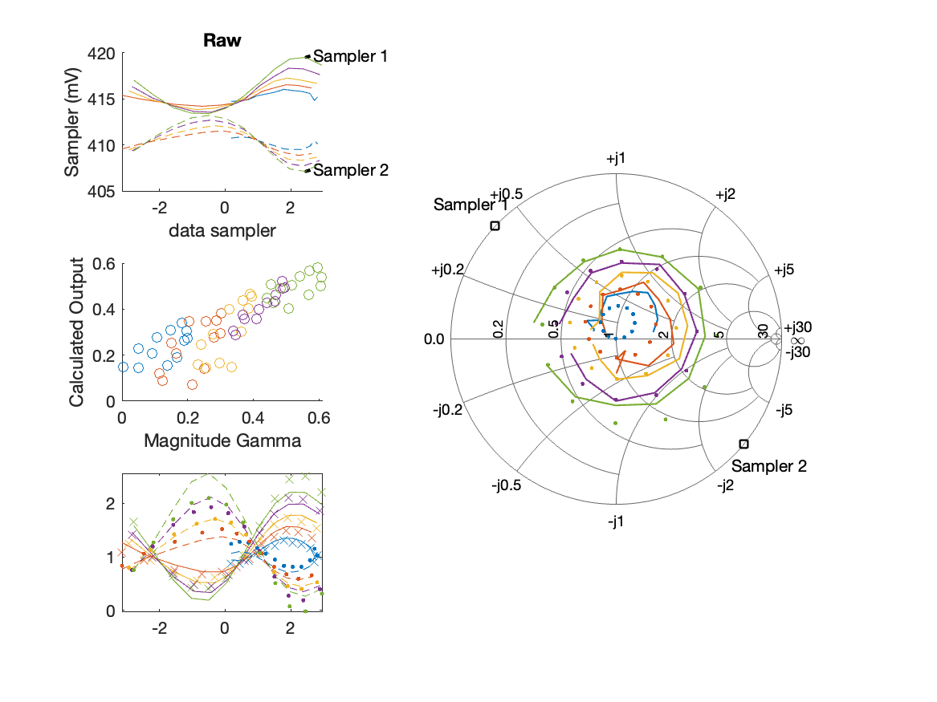
Sampler Performance Frequency 10.50 GHz, Power 8 dBm
Sampler Av
Sampler 1: 171.279
Sampler 2: 173.763
Sampler Offset (rather than -1)
-142.3579
Goodness Of fit
0.13303

Slide 6
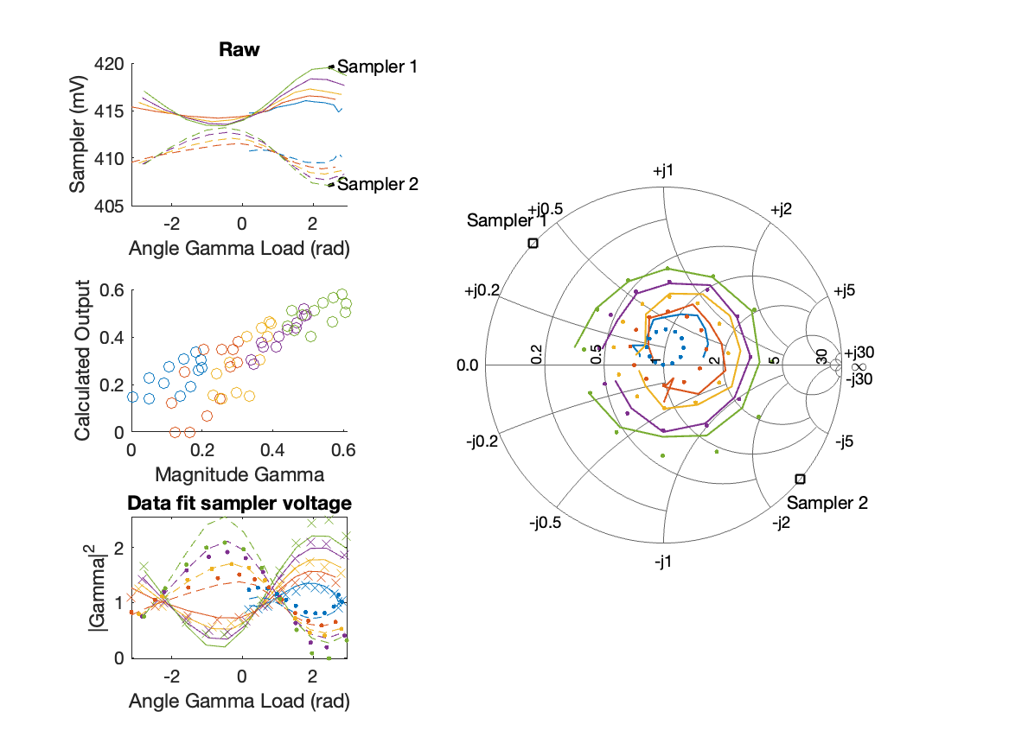
Sampler Performance x^3 Frequency 10.50 GHz, Power 8 dBm
Sampler Av
Sampler 1: 2.436125e+01
Sampler 2: 23.552
Sampler Av3
Sampler 1: 6.549
Sampler 2: 6.662
Sampler Offset (rather than -1)
-60.2565
Goodness Of fit
0.12973

Slide 7
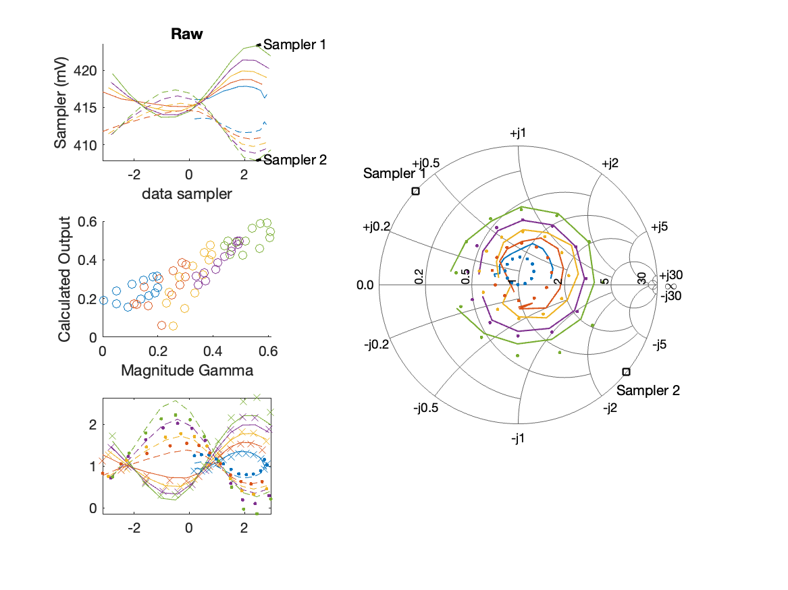
Sampler Performance Frequency 10.50 GHz, Power 10 dBm
Sampler Av
Sampler 1: 121.381
Sampler 2: 125.025
Sampler Offset (rather than -1)
-102.1388
Goodness Of fit
0.11829

Slide 8
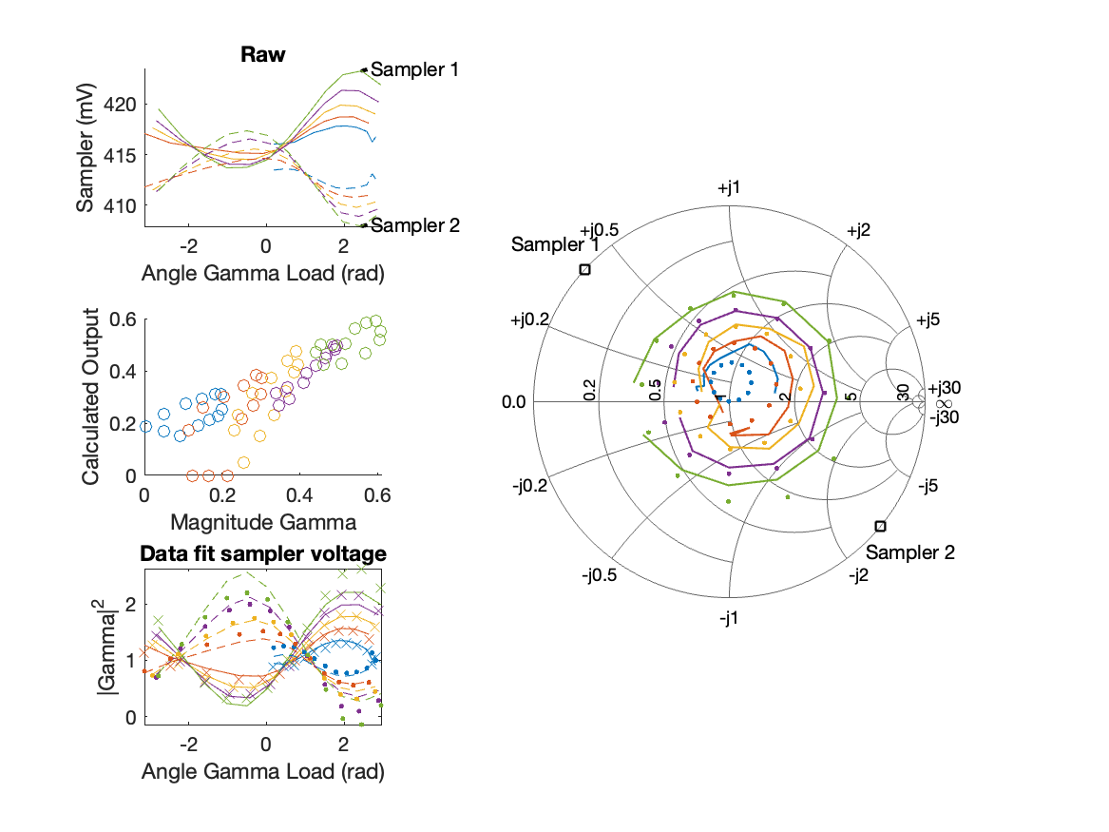
Sampler Performance x^3 Frequency 10.50 GHz, Power 10 dBm
Sampler Av
Sampler 1: 2.108953e+01
Sampler 2: 19.944
Sampler Av3
Sampler 1: 5.741
Sampler 2: 5.882
Sampler Offset (rather than -1)
-44.9746
Goodness Of fit
0.11258

Slide 9
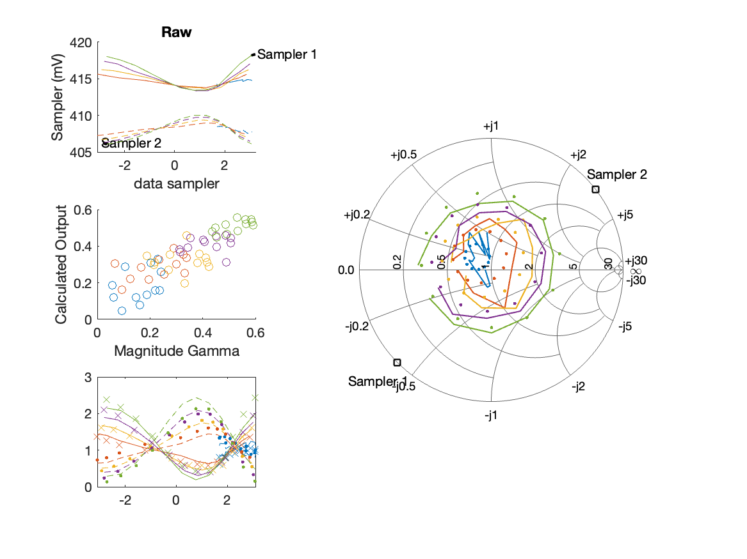
Sampler Performance Frequency 10.60 GHz, Power 6 dBm
Sampler Av
Sampler 1: 210.243
Sampler 2: 253.127
Sampler Offset (rather than -1)
-190.4126
Goodness Of fit
0.15947

Slide 10
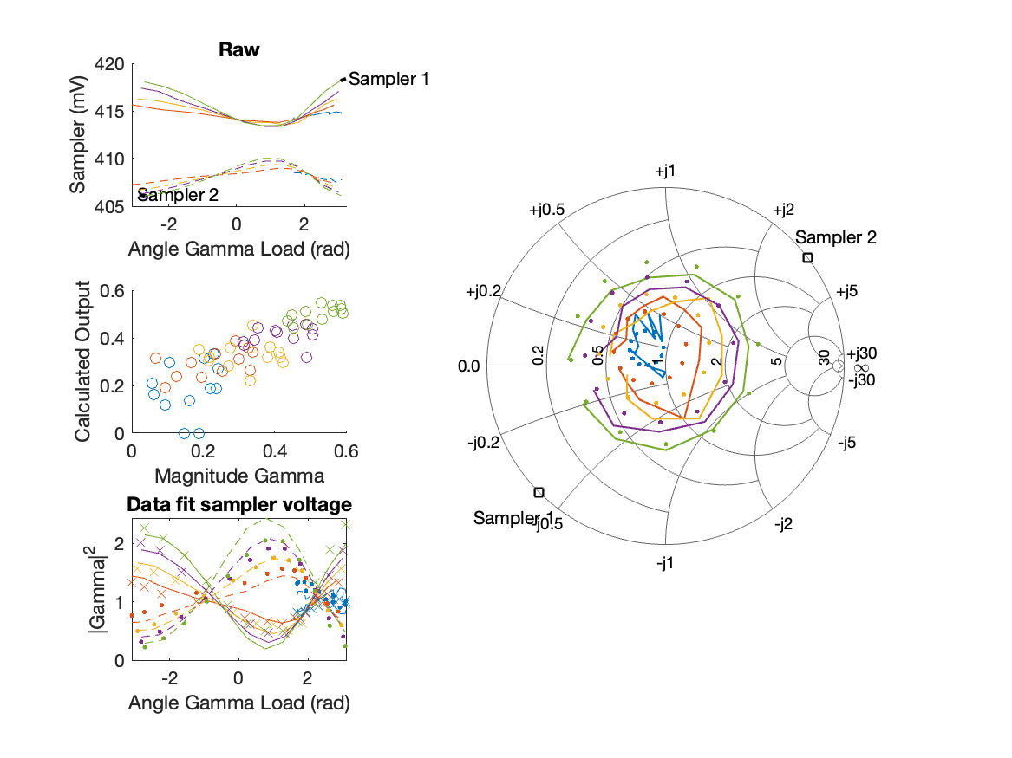
Sampler Performance x^3 Frequency 10.60 GHz, Power 6 dBm
Sampler Av
Sampler 1: 2.454550e+01
Sampler 2: 24.893
Sampler Av3
Sampler 1: 6.868
Sampler 2: 7.448
Sampler Offset (rather than -1)
-71.4432
Goodness Of fit
0.16272

Slide 11
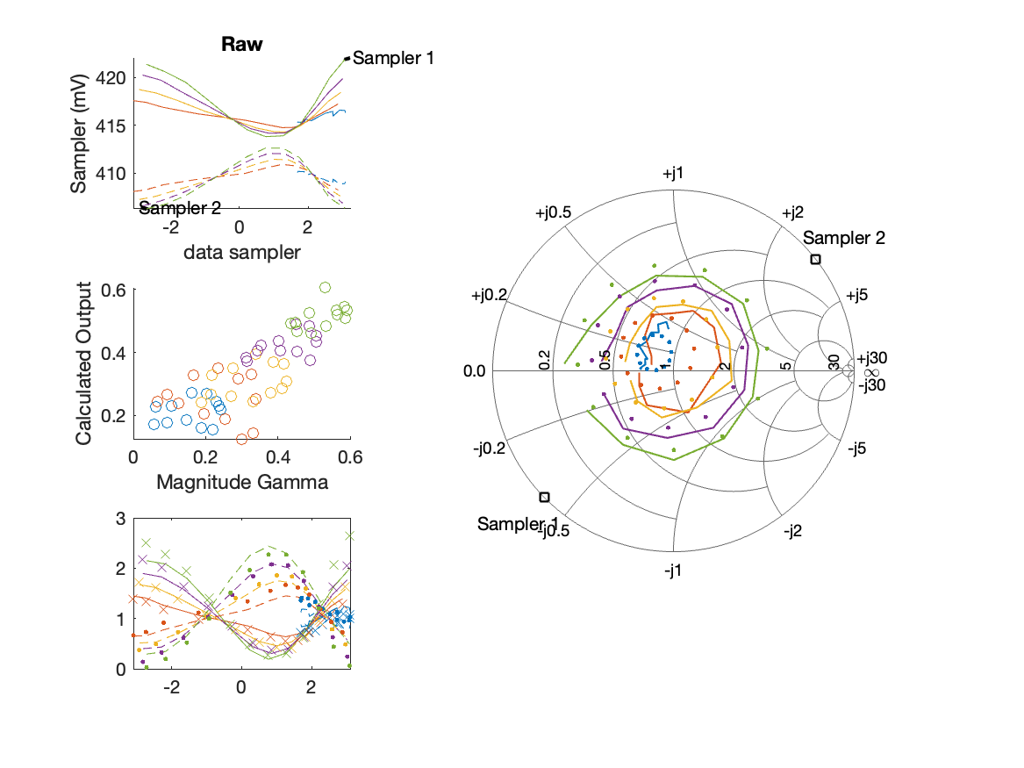
Sampler Performance Frequency 10.60 GHz, Power 8 dBm
Sampler Av
Sampler 1: 147.347
Sampler 2: 176.685
Sampler Offset (rather than -1)
-133.5919
Goodness Of fit
0.1435

Slide 12
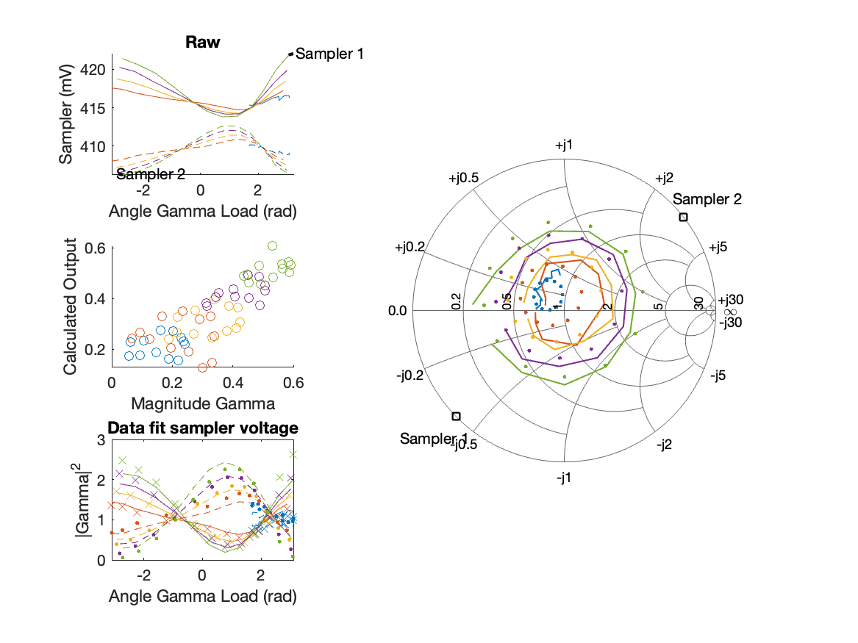
Sampler Performance x^3 Frequency 10.60 GHz, Power 8 dBm
Sampler Av
Sampler 1: 2.639644e+01
Sampler 2: 25.765
Sampler Av3
Sampler 1: 6.085
Sampler 2: 6.638
Sampler Offset (rather than -1)
-57.7777
Goodness Of fit
0.14568

Slide 13
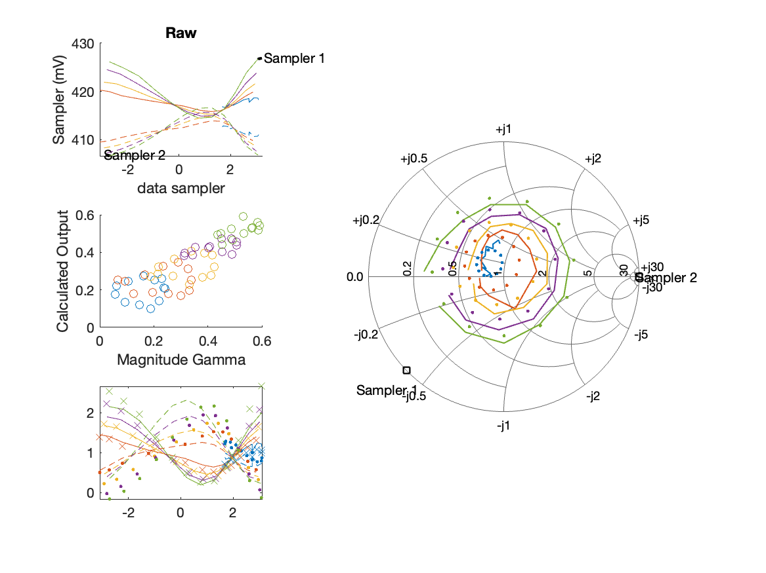
Sampler Performance Frequency 10.60 GHz, Power 10 dBm
Sampler Av
Sampler 1: 98.074
Sampler 2: 116.612
Sampler Offset (rather than -1)
-88.9408
Goodness Of fit
0.12425

Slide 14
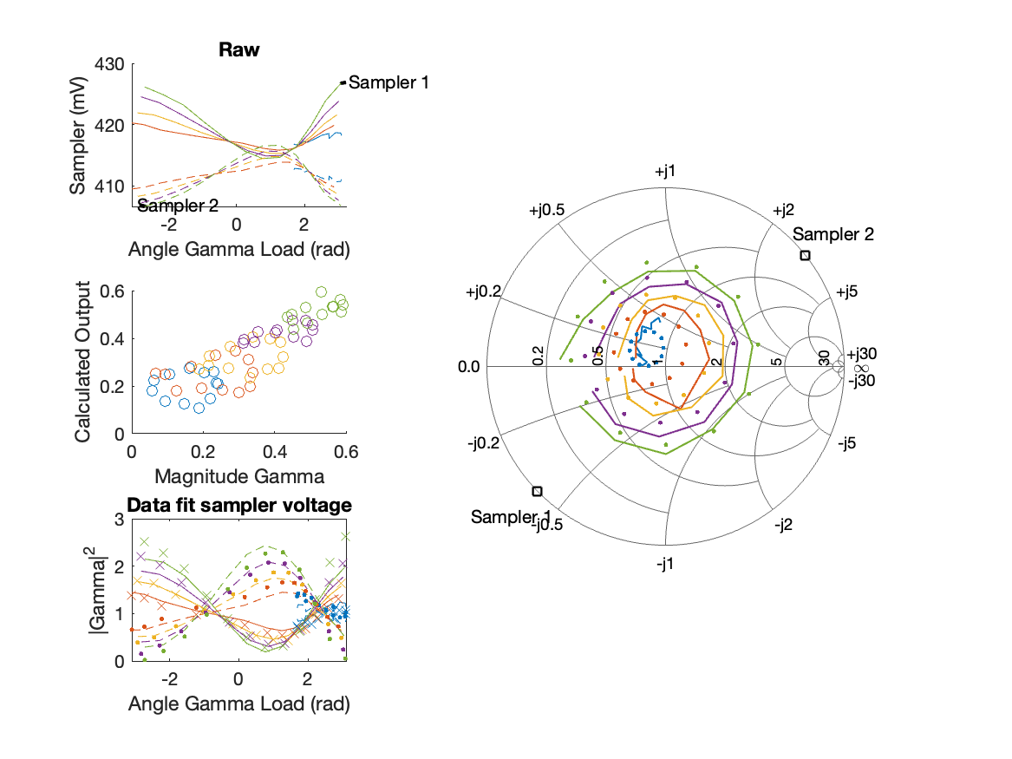
Sampler Performance x^3 Frequency 10.60 GHz, Power 10 dBm
Sampler Av
Sampler 1: 5.543200e+01
Sampler 2: 24.773
Sampler Av3
Sampler 1: 4.233
Sampler 2: 5.592
Sampler Offset (rather than -1)
-51.0527
Goodness Of fit
0.12654

Slide 15
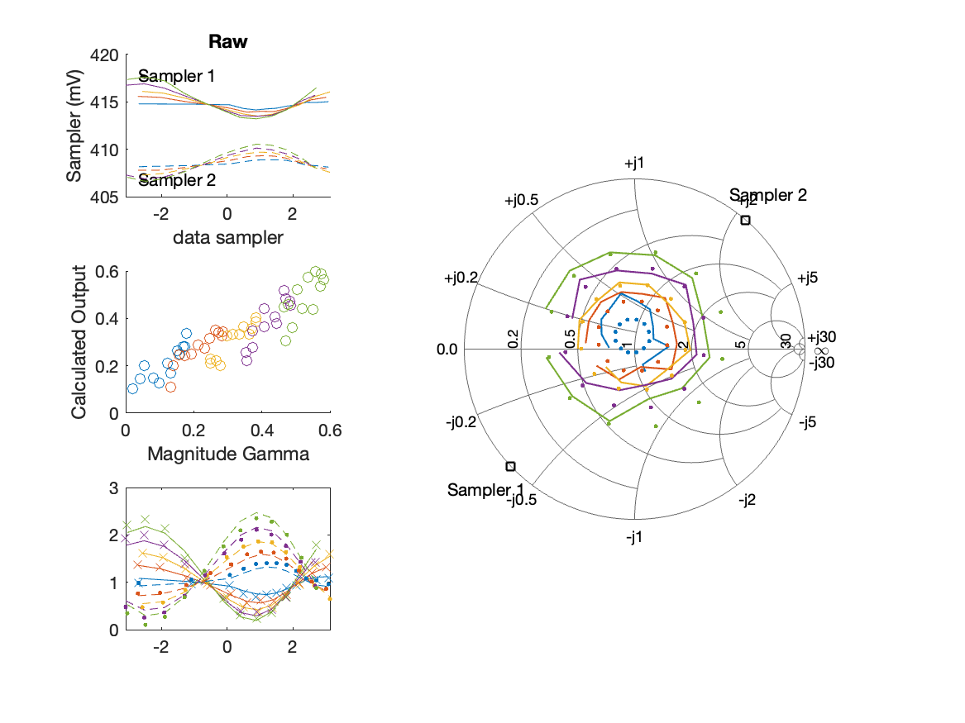
Sampler Performance Frequency 10.70 GHz, Power 6 dBm
Sampler Av
Sampler 1: 237.680
Sampler 2: 286.333
Sampler Offset (rather than -1)
-215.478
Goodness Of fit
0.11139

Slide 16
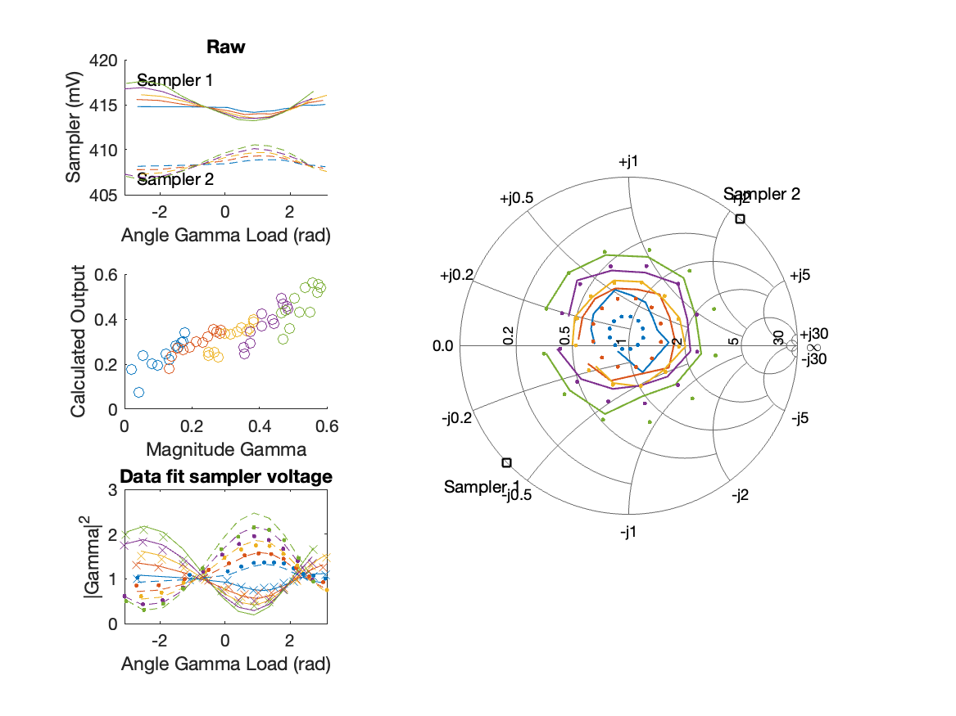
Sampler Performance x^3 Frequency 10.70 GHz, Power 6 dBm
Sampler Av
Sampler 1: 2.437118e+01
Sampler 2: 25.277
Sampler Av3
Sampler 1: 6.876
Sampler 2: 7.482
Sampler Offset (rather than -1)
-72.1018
Goodness Of fit
0.12456

Slide 17
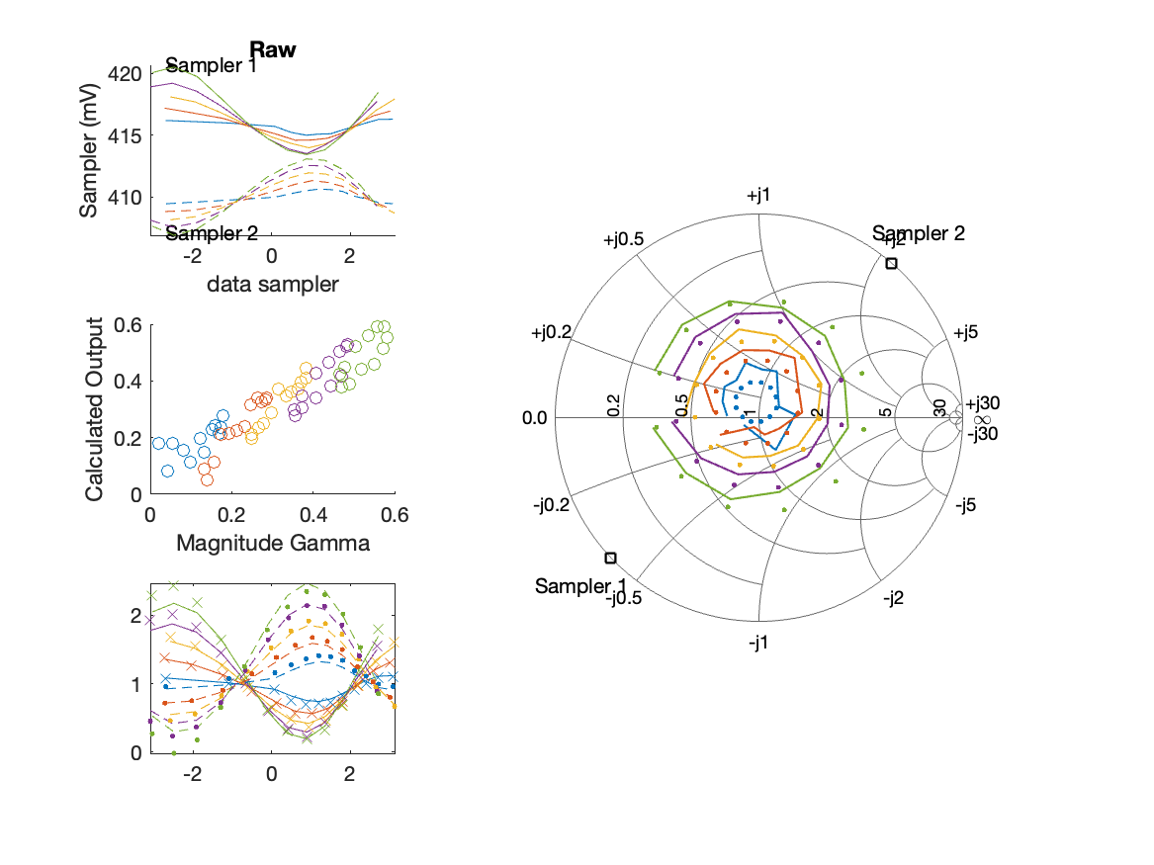
Sampler Performance Frequency 10.70 GHz, Power 8 dBm
Sampler Av
Sampler 1: 158.630
Sampler 2: 192.035
Sampler Offset (rather than -1)
-144.6465
Goodness Of fit
0.079774

Slide 18
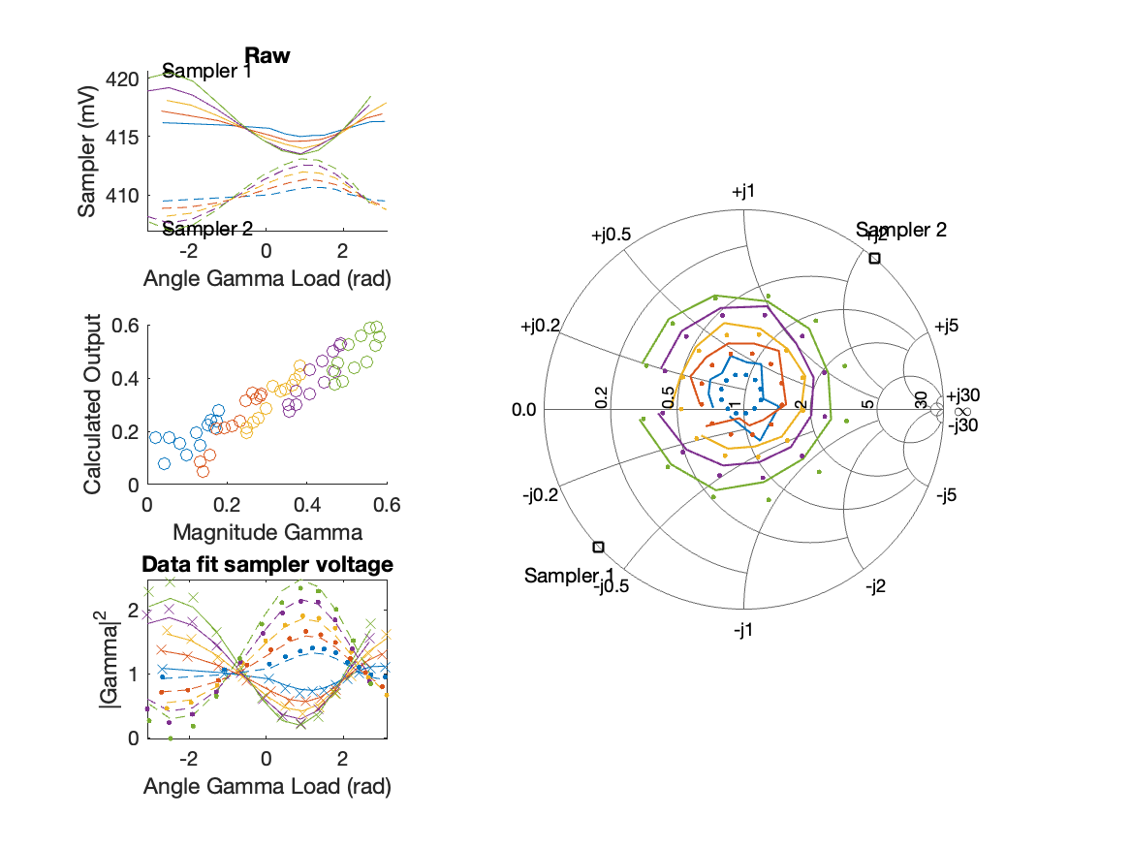
Sampler Performance x^3 Frequency 10.70 GHz, Power 8 dBm
Sampler Av
Sampler 1: 2.265048e+01
Sampler 2: 23.393
Sampler Av3
Sampler 1: 6.369
Sampler 2: 6.917
Sampler Offset (rather than -1)
-60.3502
Goodness Of fit
0.076867

Slide 19
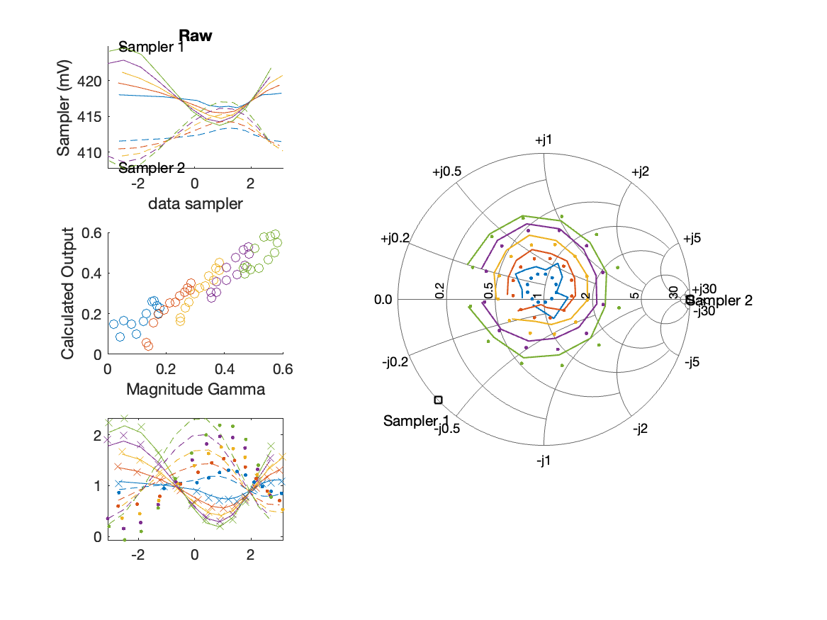
Sampler Performance Frequency 10.70 GHz, Power 10 dBm
Sampler Av
Sampler 1: 97.497
Sampler 2: 120.293
Sampler Offset (rather than -1)
-90.2507
Goodness Of fit
0.074834

Slide 20
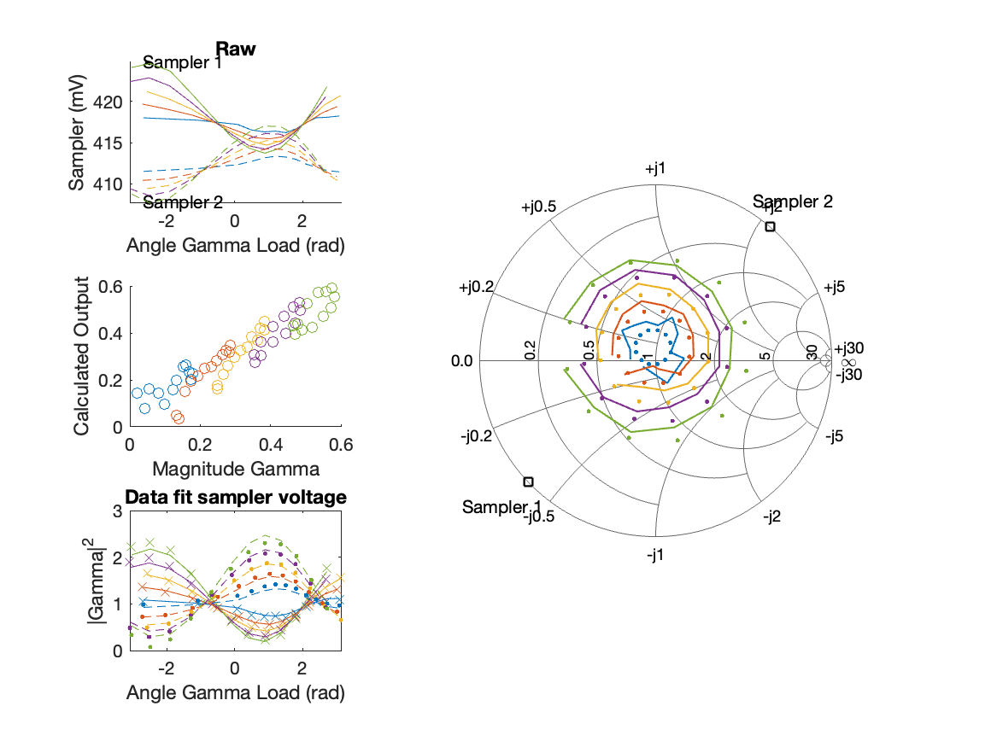
Sampler Performance x^3 Frequency 10.70 GHz, Power 10 dBm
Sampler Av
Sampler 1: 1.770969e+01
Sampler 2: 17.951
Sampler Av3
Sampler 1: 5.309
Sampler 2: 5.829
Sampler Offset (rather than -1)
-39.5152
Goodness Of fit
0.070148

Slide 21
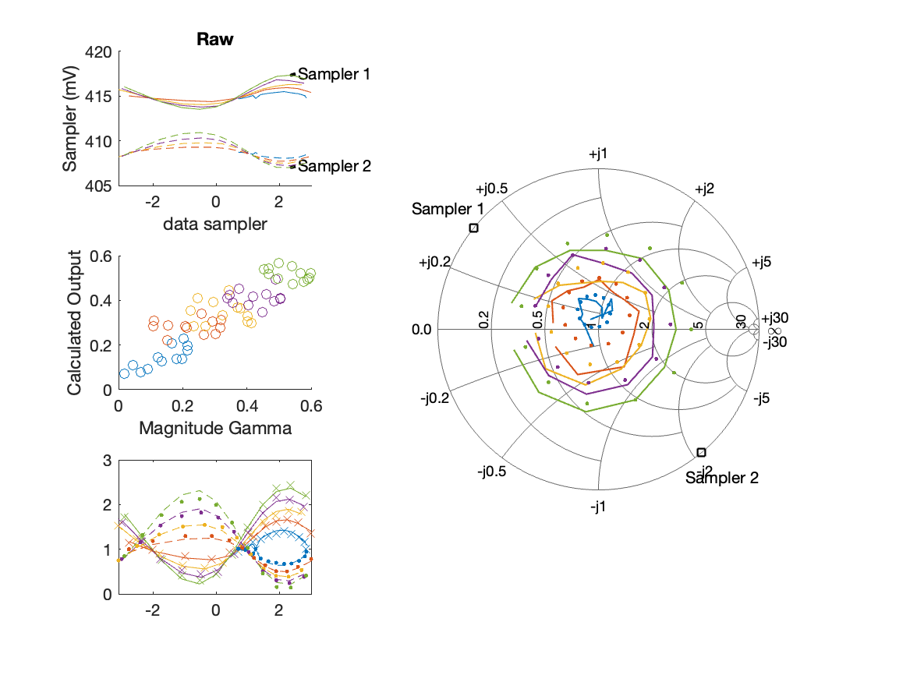
Sampler Performance Frequency 10.80 GHz, Power 6 dBm
Sampler Av
Sampler 1: 280.895
Sampler 2: 253.309
Sampler Offset (rather than -1)
-220.0237
Goodness Of fit
0.17413

Slide 22
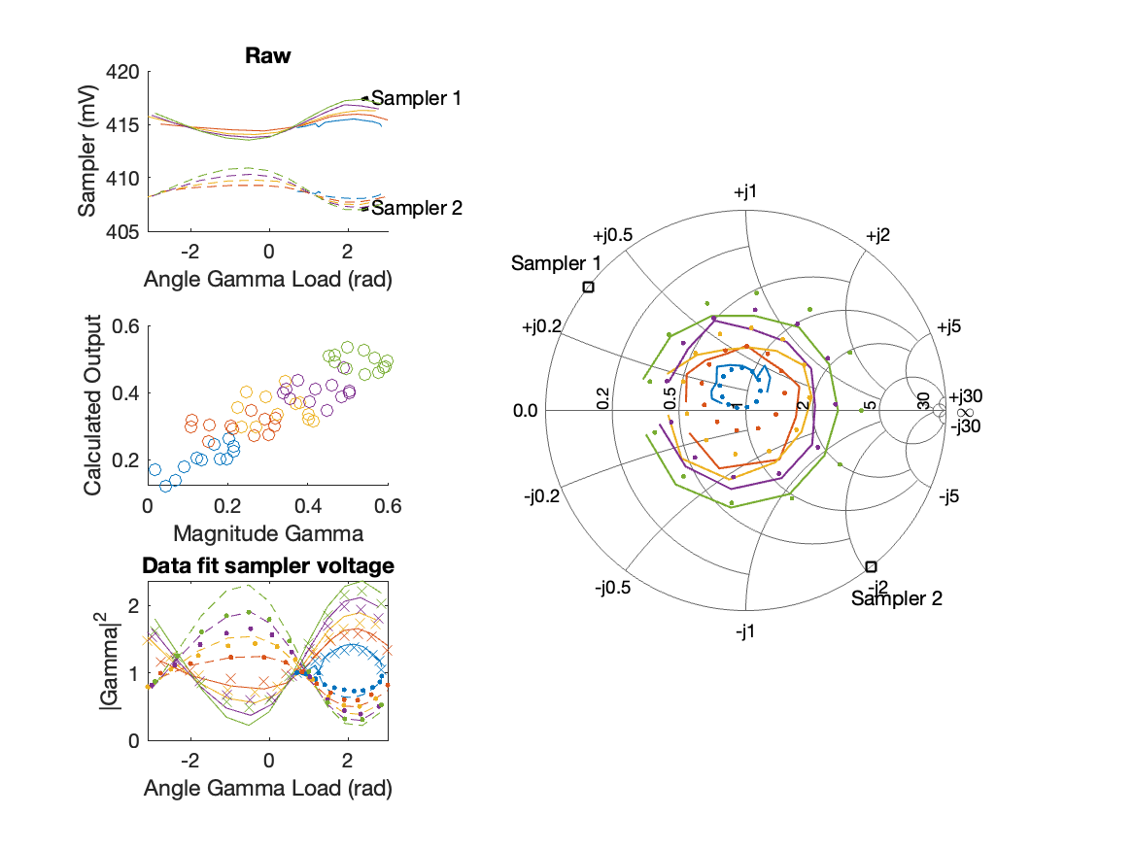
Sampler Performance x^3 Frequency 10.80 GHz, Power 6 dBm
Sampler Av
Sampler 1: 2.529164e+01
Sampler 2: 24.574
Sampler Av3
Sampler 1: 7.312
Sampler 2: 7.090
Sampler Offset (rather than -1)
-72.7322
Goodness Of fit
0.18886

Slide 23
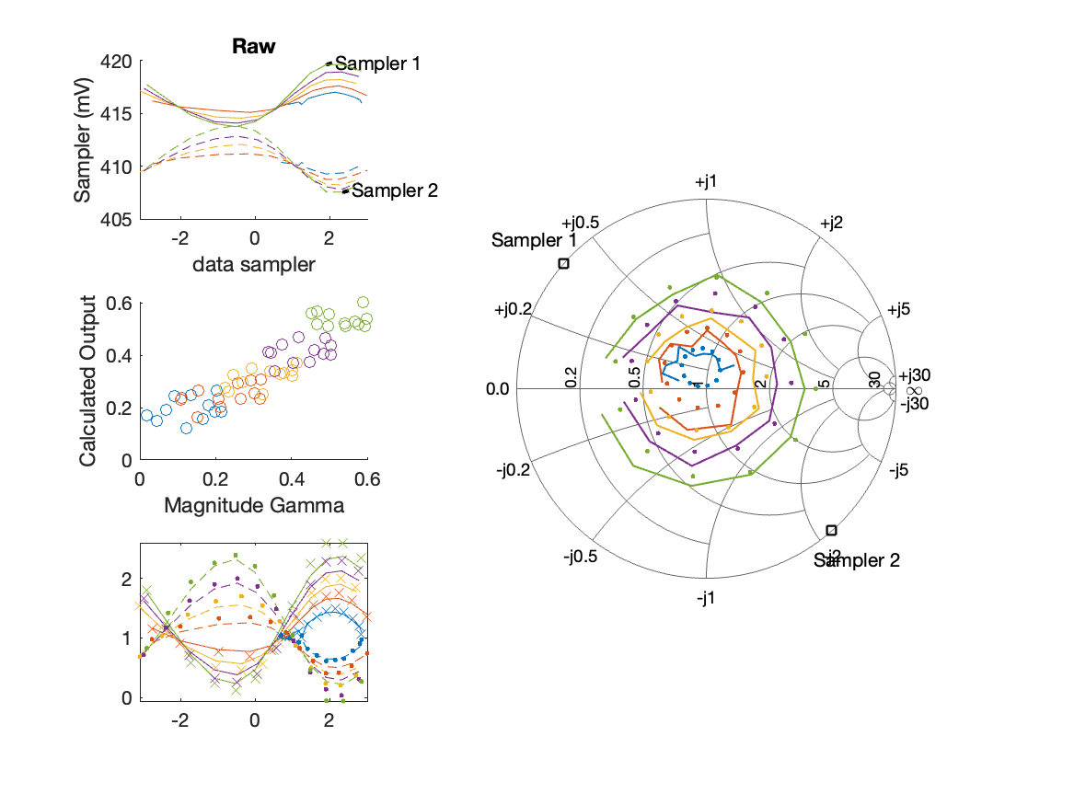
Sampler Performance Frequency 10.80 GHz, Power 8 dBm
Sampler Av
Sampler 1: 210.328
Sampler 2: 194.120
Sampler Offset (rather than -1)
-167.0968
Goodness Of fit
0.11541

Slide 24
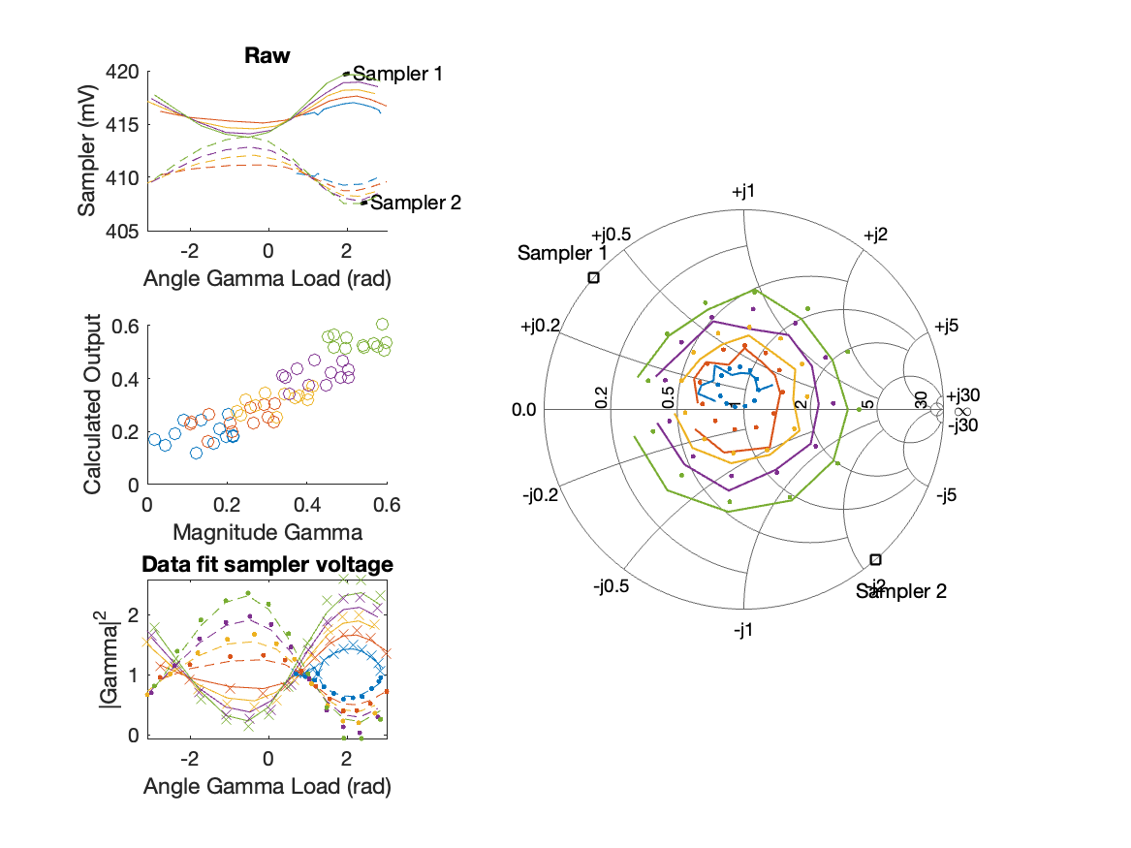
Sampler Performance x^3 Frequency 10.80 GHz, Power 8 dBm
Sampler Av
Sampler 1: 2.418772e+01
Sampler 2: 22.678
Sampler Av3
Sampler 1: 7.071
Sampler 2: 6.946
Sampler Offset (rather than -1)
-67.9184
Goodness Of fit
0.11257

Slide 25

Sampler Performance Frequency 10.80 GHz, Power 10 dBm
Sampler Av
Sampler 1: 145.116
Sampler 2: 135.212
Sampler Offset (rather than -1)
-116.3578
Goodness Of fit
0.10936

Slide 26
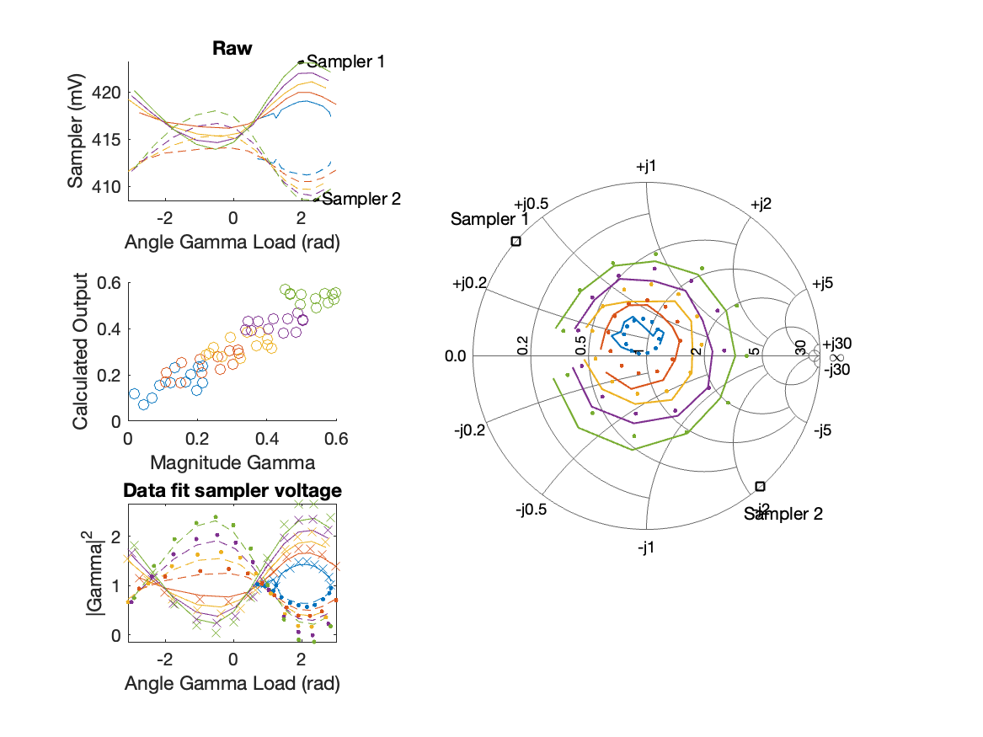
Sampler Performance x^3 Frequency 10.80 GHz, Power 10 dBm
Sampler Av
Sampler 1: 1.683943e+01
Sampler 2: 15.855
Sampler Av3
Sampler 1: 6.212
Sampler 2: 6.116
Sampler Offset (rather than -1)
-47.0656
Goodness Of fit
0.10491

Slide 27
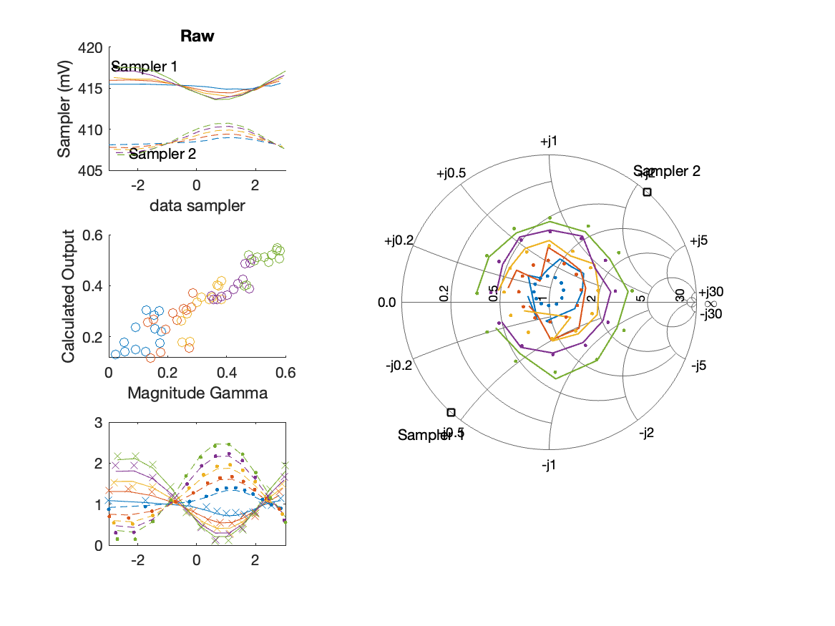
Sampler Performance Frequency 10.90 GHz, Power 6 dBm
Sampler Av
Sampler 1: 265.573
Sampler 2: 300.000
Sampler Offset (rather than -1)
-232.7902
Goodness Of fit
0.08276

Slide 28
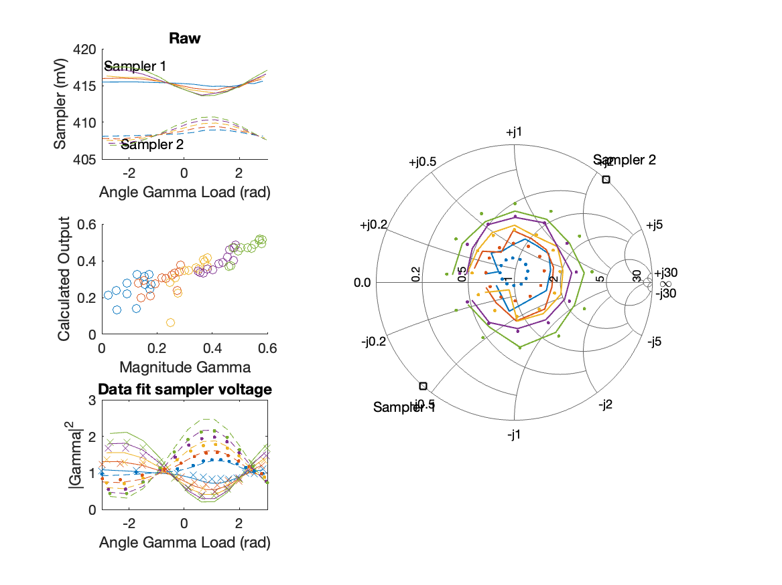
Sampler Performance x^3 Frequency 10.90 GHz, Power 6 dBm
Sampler Av
Sampler 1: 2.440019e+01
Sampler 2: 25.766
Sampler Av3
Sampler 1: 6.819
Sampler 2: 7.325
Sampler Offset (rather than -1)
-70.0837
Goodness Of fit
0.12641

Slide 29
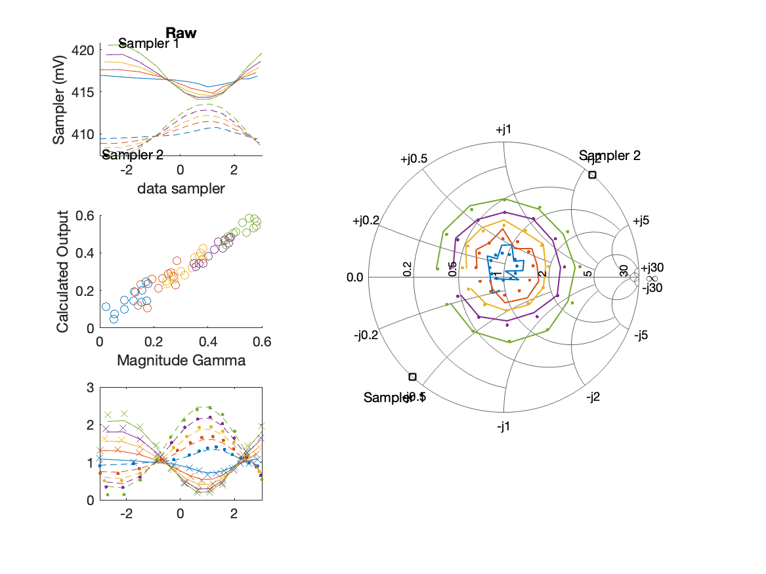
Sampler Performance Frequency 10.90 GHz, Power 8 dBm
Sampler Av
Sampler 1: 161.753
Sampler 2: 187.530
Sampler Offset (rather than -1)
-144.2159
Goodness Of fit
0.025366

Slide 30
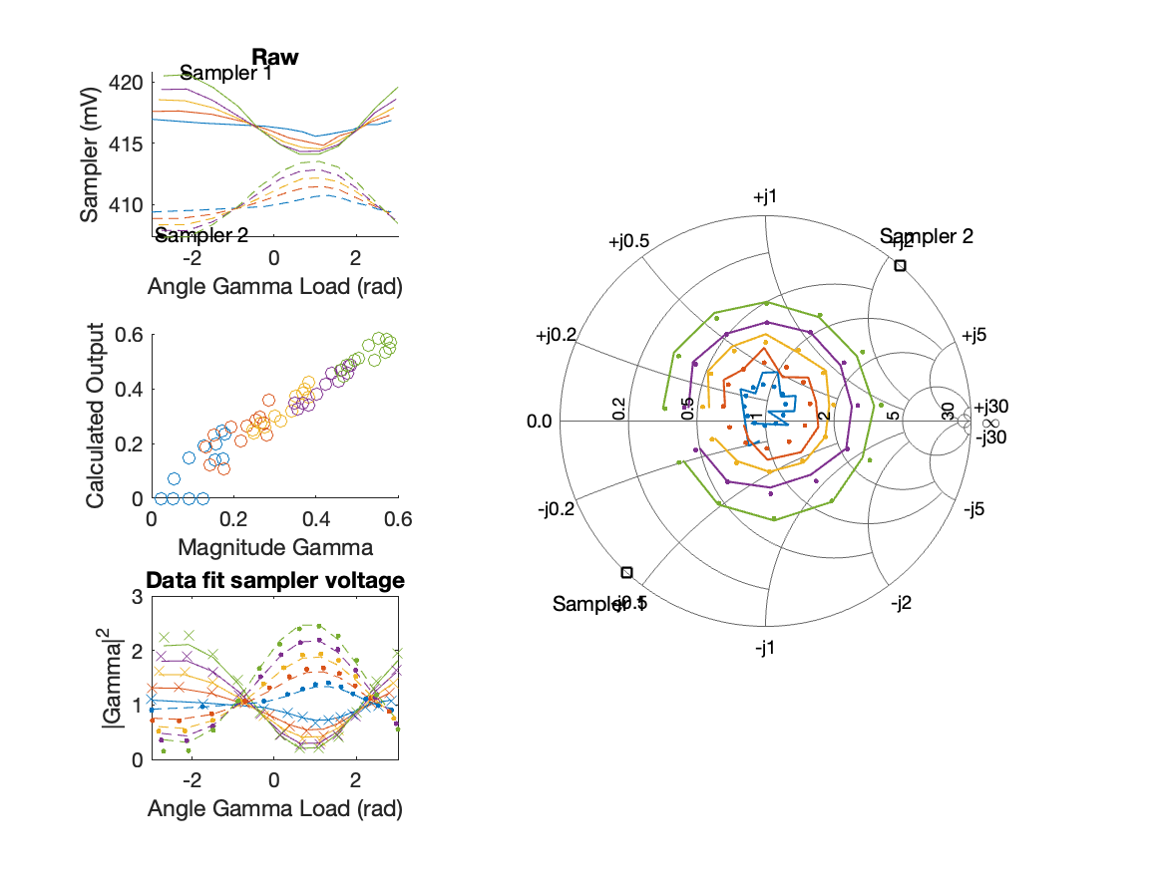
Sampler Performance x^3 Frequency 10.90 GHz, Power 8 dBm
Sampler Av
Sampler 1: 2.488749e+01
Sampler 2: 25.680
Sampler Av3
Sampler 1: 6.375
Sampler 2: 6.817
Sampler Offset (rather than -1)
-61.3999
Goodness Of fit
0.023814

Slide 31
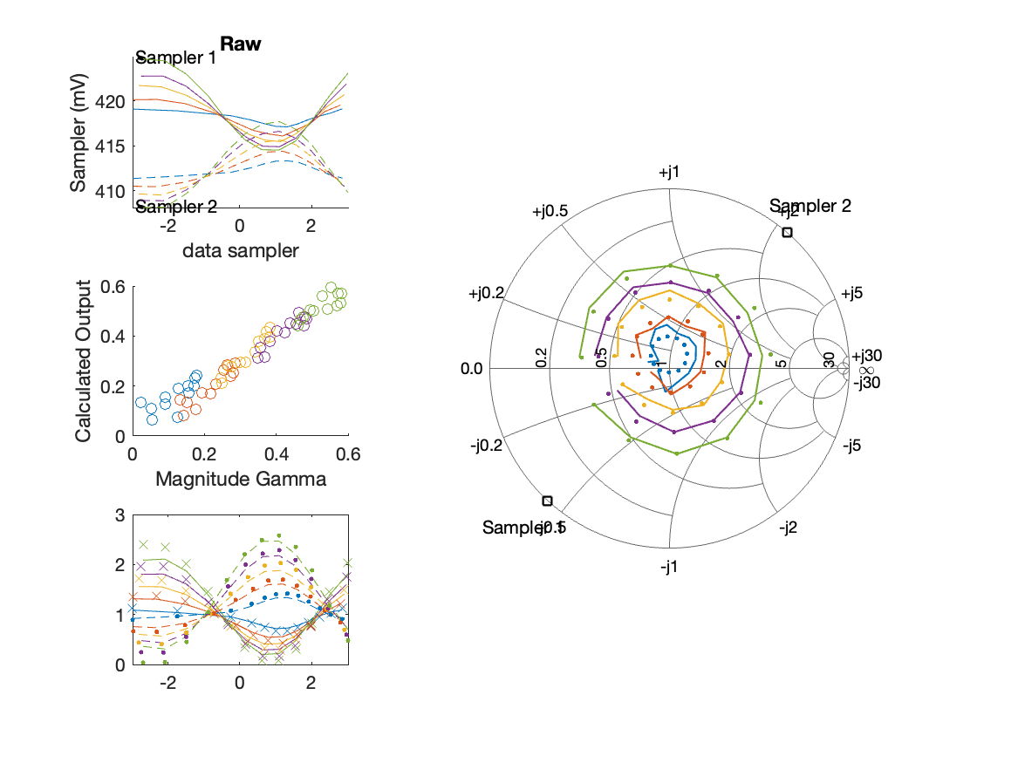
Sampler Performance Frequency 10.90 GHz, Power 10 dBm
Sampler Av
Sampler 1: 114.327
Sampler 2: 132.391
Sampler Offset (rather than -1)
-102.3699
Goodness Of fit
0.024656

Slide 32
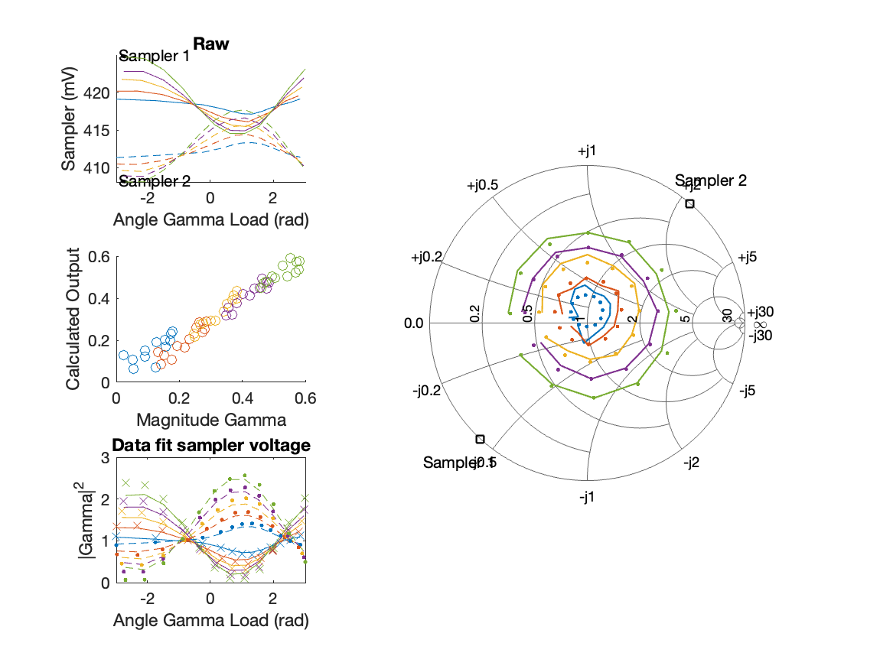
Sampler Performance x^3 Frequency 10.90 GHz, Power 10 dBm
Sampler Av
Sampler 1: 2.377150e+01
Sampler 2: 23.930
Sampler Av3
Sampler 1: 5.521
Sampler 2: 5.928
Sampler Offset (rather than -1)
-46.6933
Goodness Of fit
0.021886

Slide 33
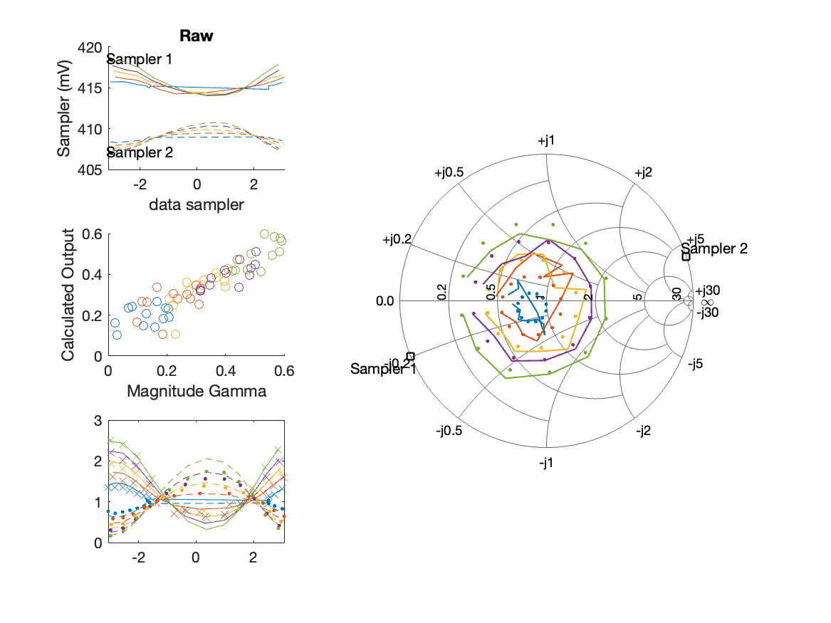
Sampler Performance Frequency 11.00 GHz, Power 6 dBm
Sampler Av
Sampler 1: 217.526
Sampler 2: 208.553
Sampler Offset (rather than -1)
-175.5443
Goodness Of fit
0.098969

Slide 34
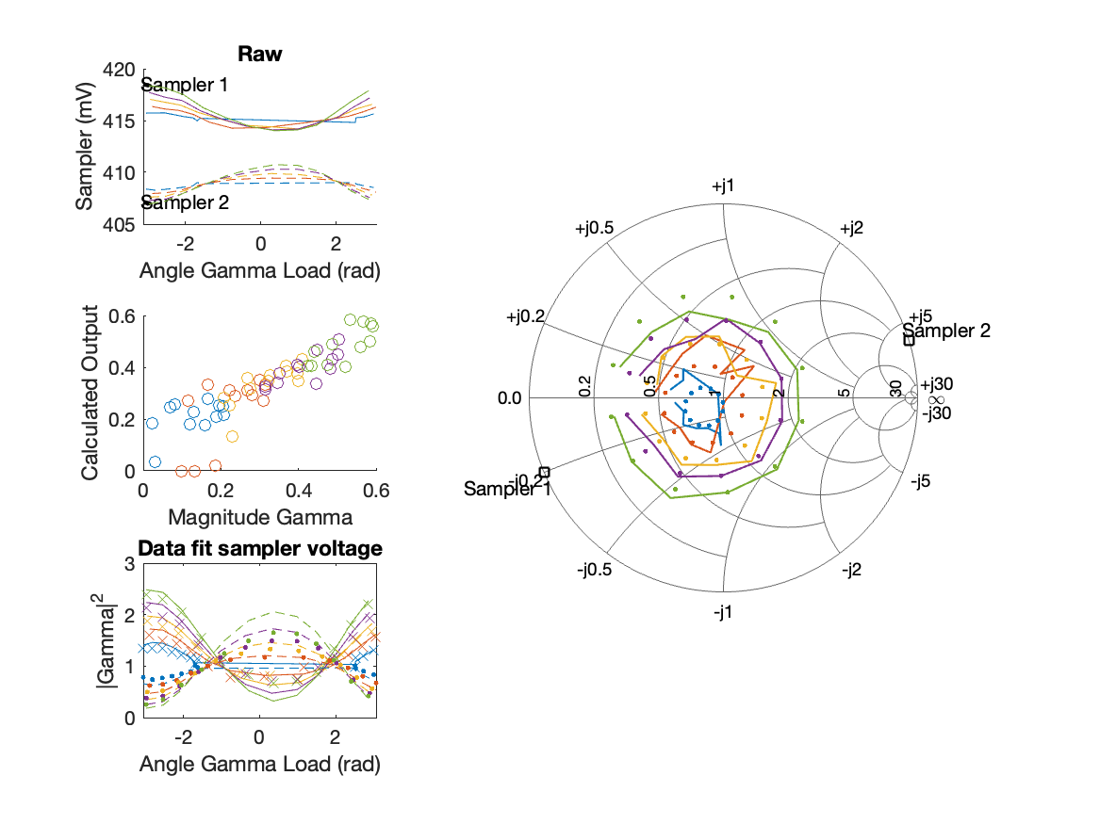
Sampler Performance x^3 Frequency 11.00 GHz, Power 6 dBm
Sampler Av
Sampler 1: 2.619394e+01
Sampler 2: 25.264
Sampler Av3
Sampler 1: 6.911
Sampler 2: 6.821
Sampler Offset (rather than -1)
-66.4754
Goodness Of fit
0.10166

Slide 35
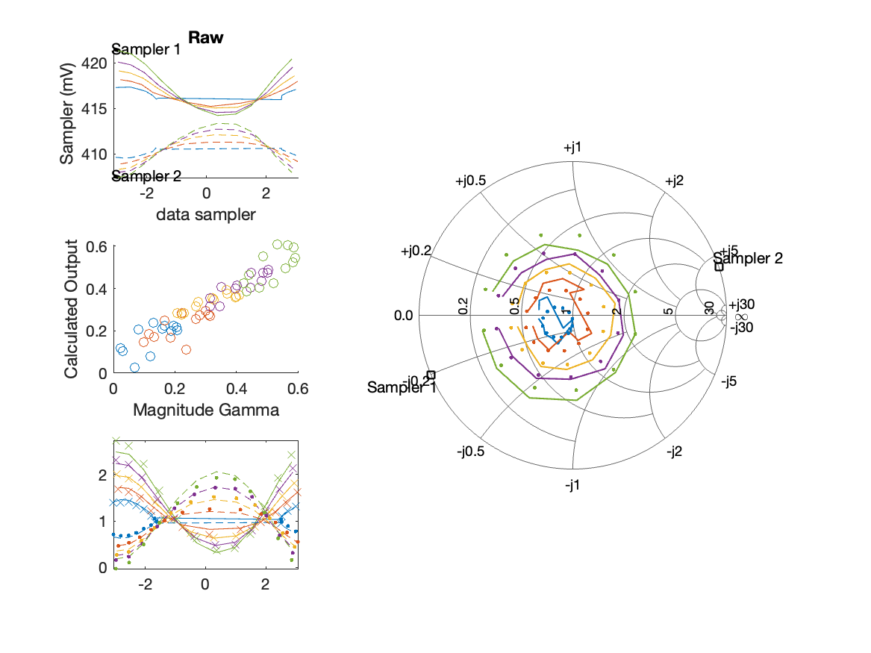
Sampler Performance Frequency 11.00 GHz, Power 8 dBm
Sampler Av
Sampler 1: 165.370
Sampler 2: 163.231
Sampler Offset (rather than -1)
-135.8252
Goodness Of fit
0.068188

Slide 36
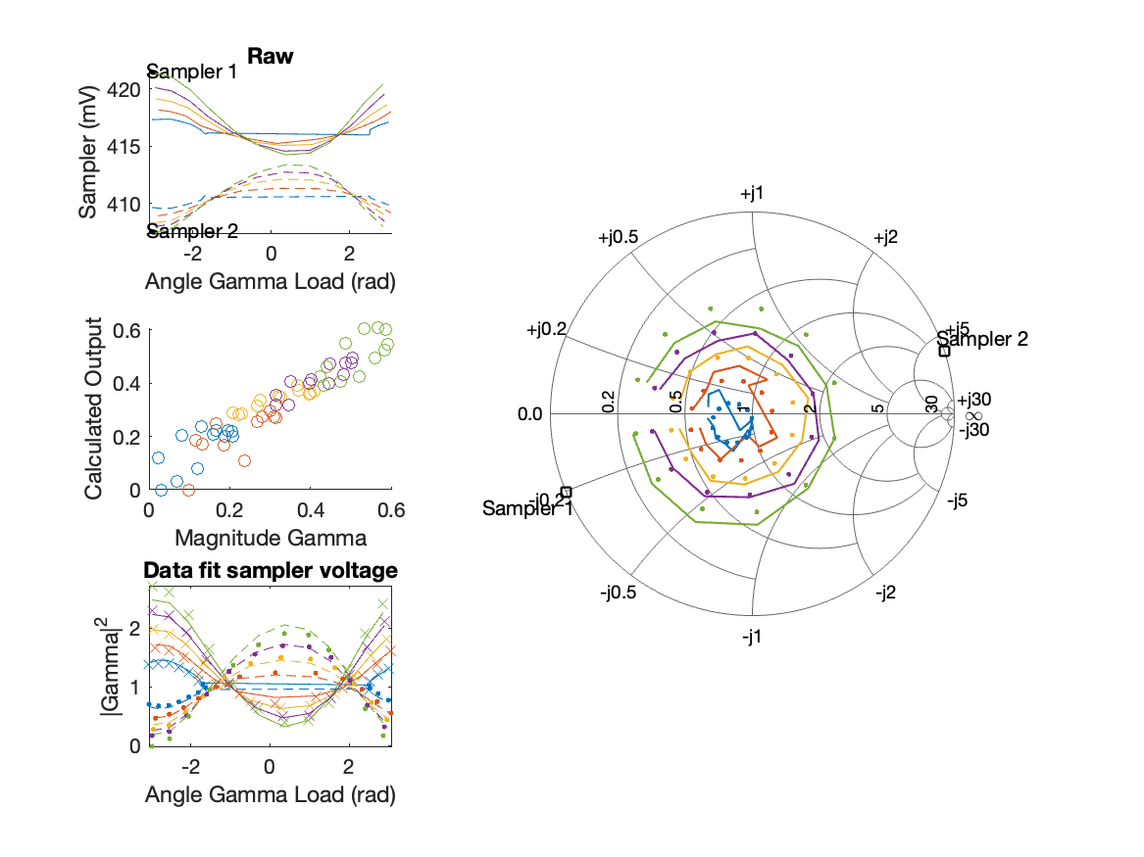
Sampler Performance x^3 Frequency 11.00 GHz, Power 8 dBm
Sampler Av
Sampler 1: 2.613778e+01
Sampler 2: 24.826
Sampler Av3
Sampler 1: 6.407
Sampler 2: 6.463
Sampler Offset (rather than -1)
-58.6956
Goodness Of fit
0.067066

Slide 37
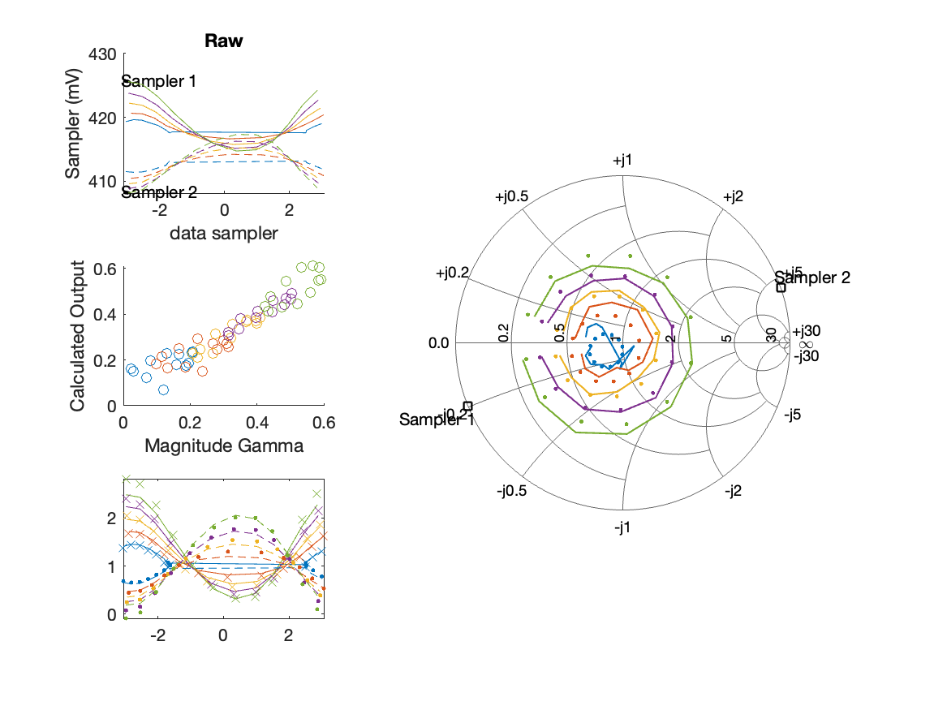
Sampler Performance Frequency 11.00 GHz, Power 10 dBm
Sampler Av
Sampler 1: 114.401
Sampler 2: 114.083
Sampler Offset (rather than -1)
-94.8814
Goodness Of fit
0.051221

Slide 38
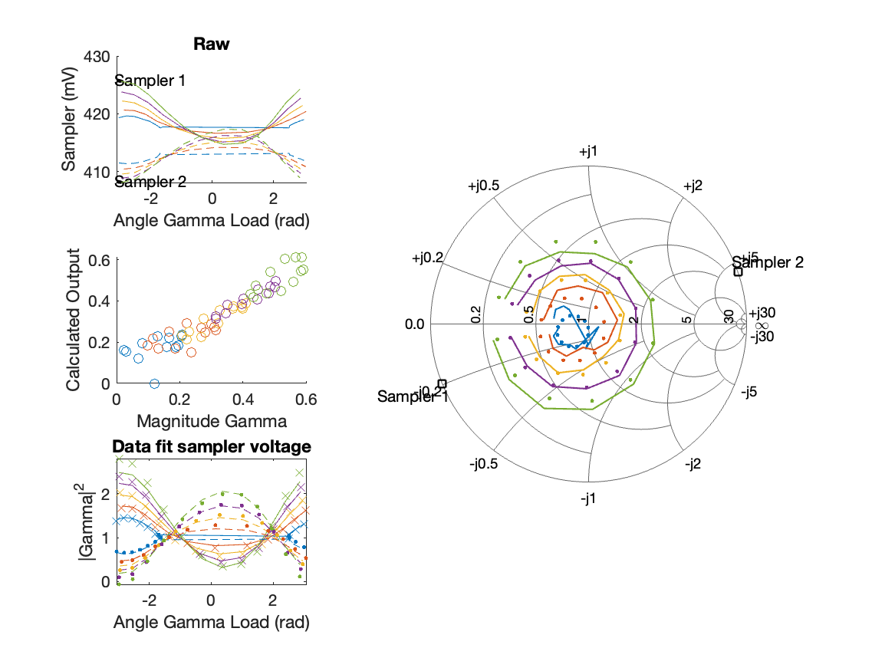
Sampler Performance x^3 Frequency 11.00 GHz, Power 10 dBm
Sampler Av
Sampler 1: 2.693458e+01
Sampler 2: 25.126
Sampler Av3
Sampler 1: 5.448
Sampler 2: 5.533
Sampler Offset (rather than -1)
-45.3243
Goodness Of fit
0.050777

Slide 39
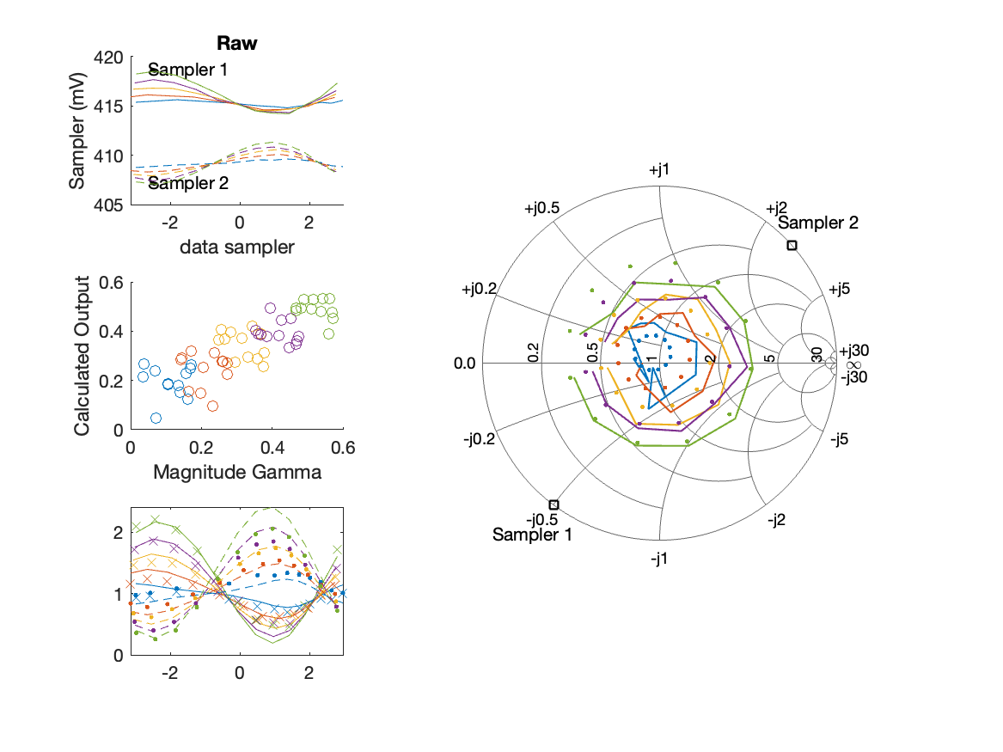
Sampler Performance Frequency 11.10 GHz, Power 6 dBm
Sampler Av
Sampler 1: 203.140
Sampler 2: 211.487
Sampler Offset (rather than -1)
-170.8621
Goodness Of fit
0.18077

Slide 40
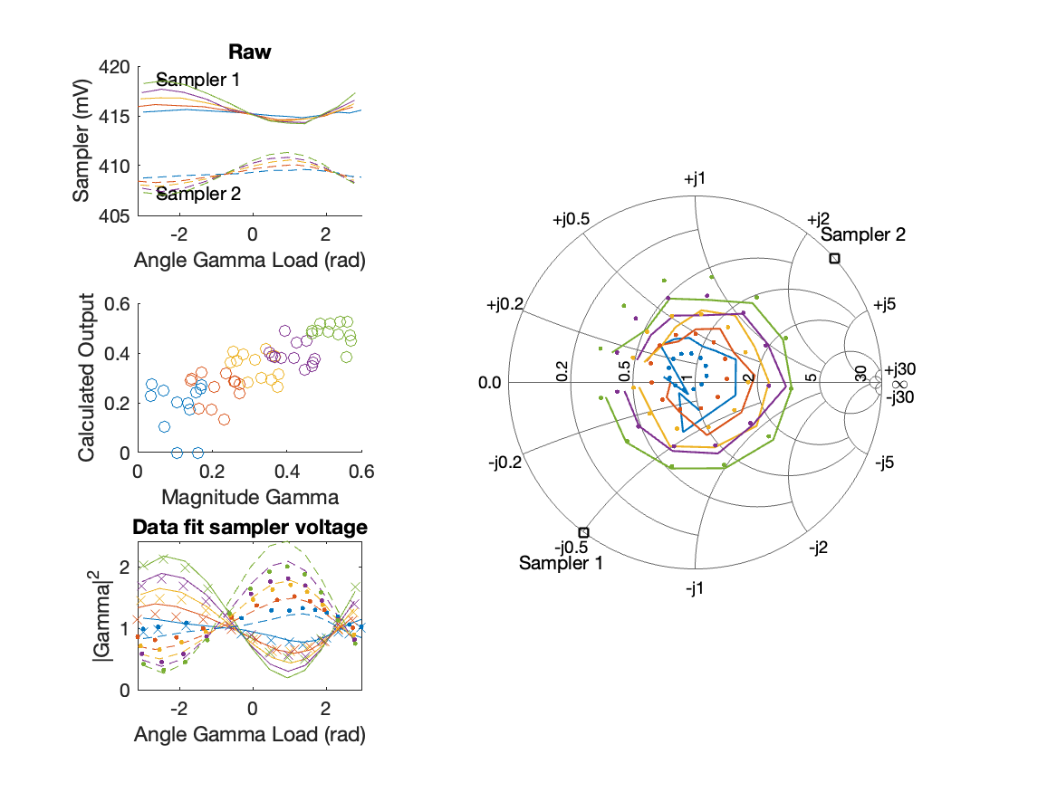
Sampler Performance x^3 Frequency 11.10 GHz, Power 6 dBm
Sampler Av
Sampler 1: 2.473935e+01
Sampler 2: 24.995
Sampler Av3
Sampler 1: 6.817
Sampler 2: 6.998
Sampler Offset (rather than -1)
-66.6208
Goodness Of fit
0.18158

Slide 41
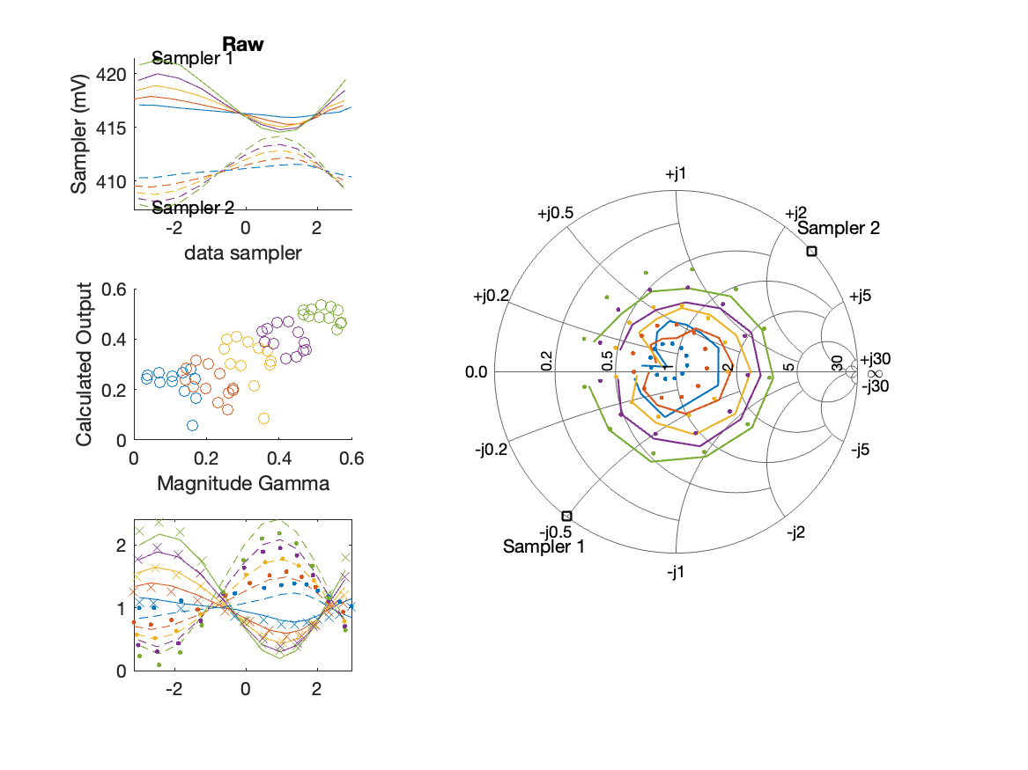
Sampler Performance Frequency 11.10 GHz, Power 8 dBm
Sampler Av
Sampler 1: 151.659
Sampler 2: 154.048
Sampler Offset (rather than -1)
-126.4112
Goodness Of fit
0.19573

Slide 42
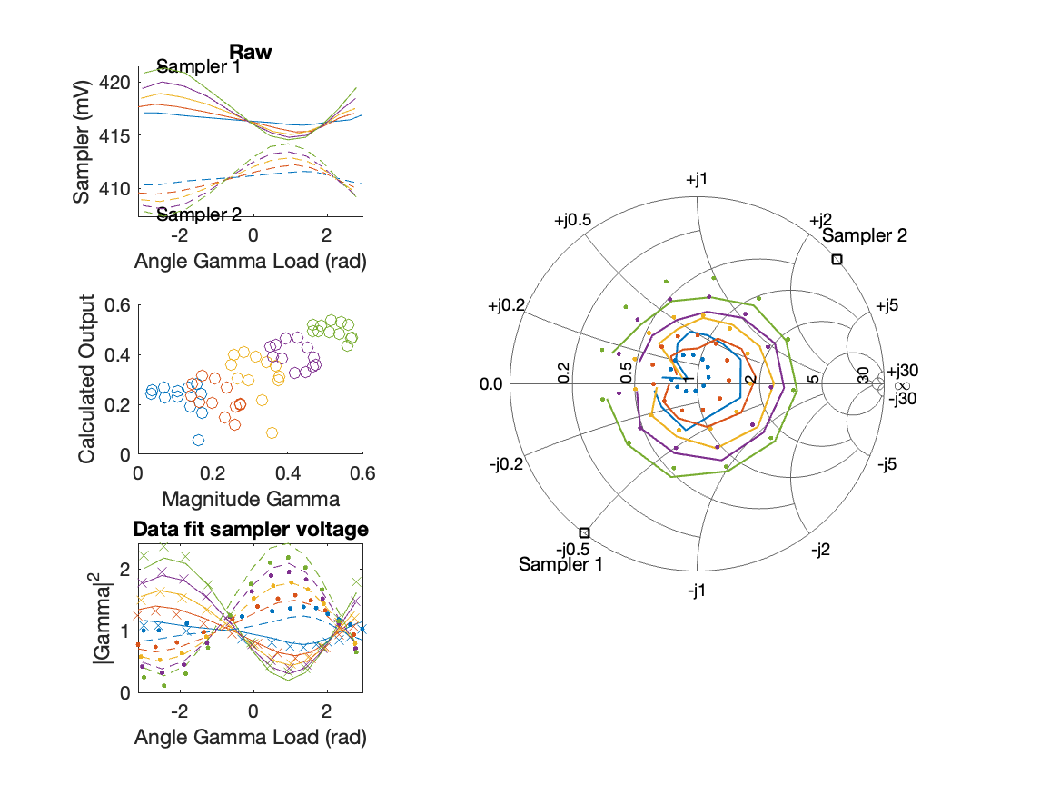
Sampler Performance x^3 Frequency 11.10 GHz, Power 8 dBm
Sampler Av
Sampler 1: 2.524761e+01
Sampler 2: 25.270
Sampler Av3
Sampler 1: 6.201
Sampler 2: 6.309
Sampler Offset (rather than -1)
-55.5014
Goodness Of fit
0.19383

Slide 43
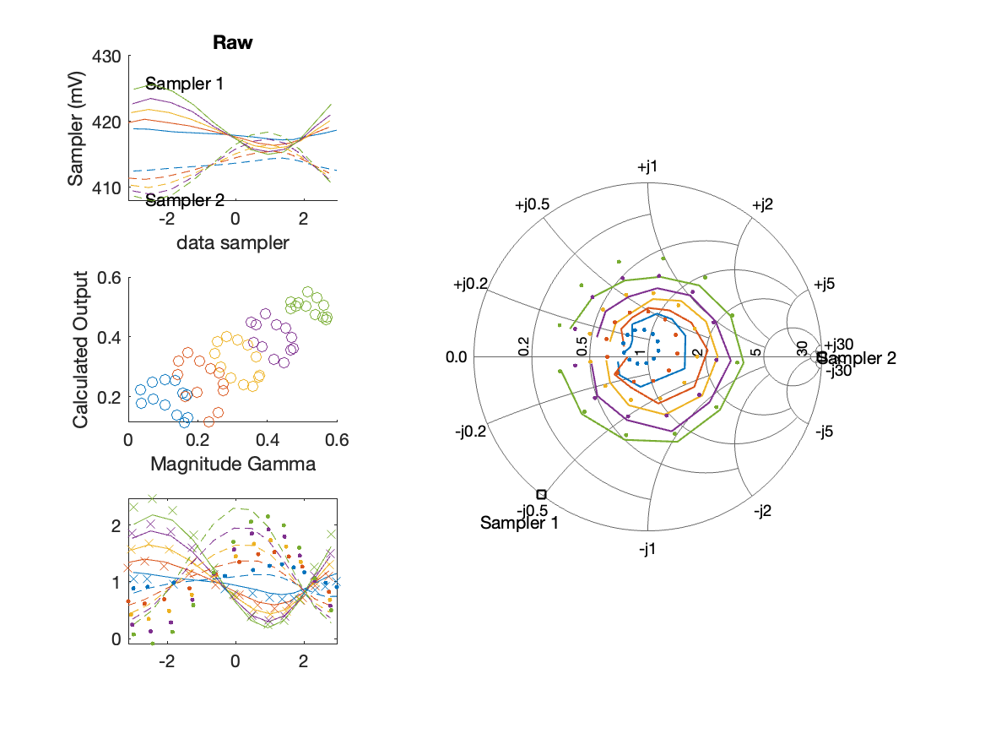
Sampler Performance Frequency 11.10 GHz, Power 10 dBm
Sampler Av
Sampler 1: 104.621
Sampler 2: 106.729
Sampler Offset (rather than -1)
-87.8204
Goodness Of fit
0.18064

Slide 44
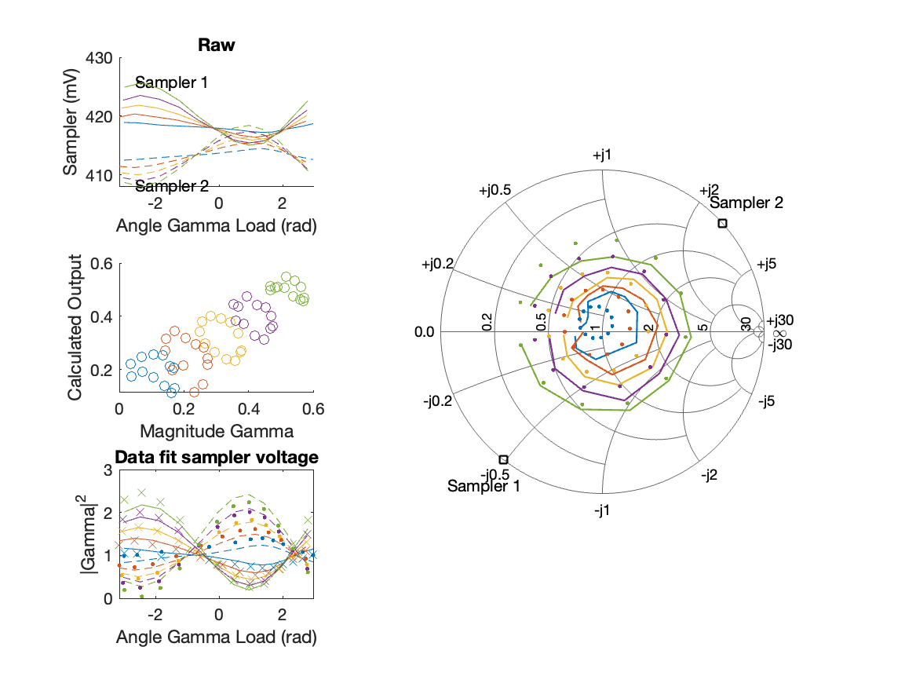
Sampler Performance x^3 Frequency 11.10 GHz, Power 10 dBm
Sampler Av
Sampler 1: 2.448859e+01
Sampler 2: 22.658
Sampler Av3
Sampler 1: 5.292
Sampler 2: 5.437
Sampler Offset (rather than -1)
-41.7518
Goodness Of fit
0.17804

Slide 45
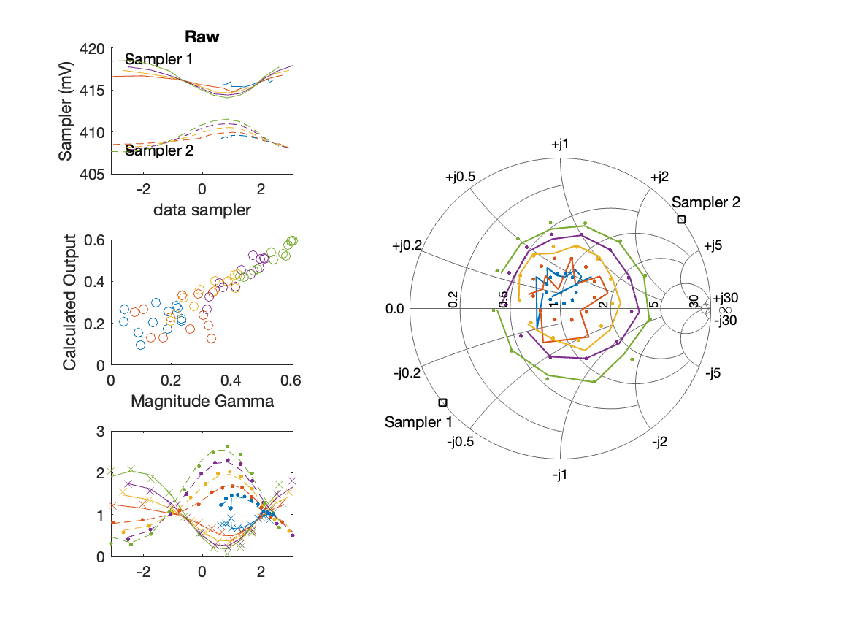
Sampler Performance Frequency 11.20 GHz, Power 6 dBm
Sampler Av
Sampler 1: 225.333
Sampler 2: 300.000
Sampler Offset (rather than -1)
-216.4144
Goodness Of fit
0.071427

Slide 46
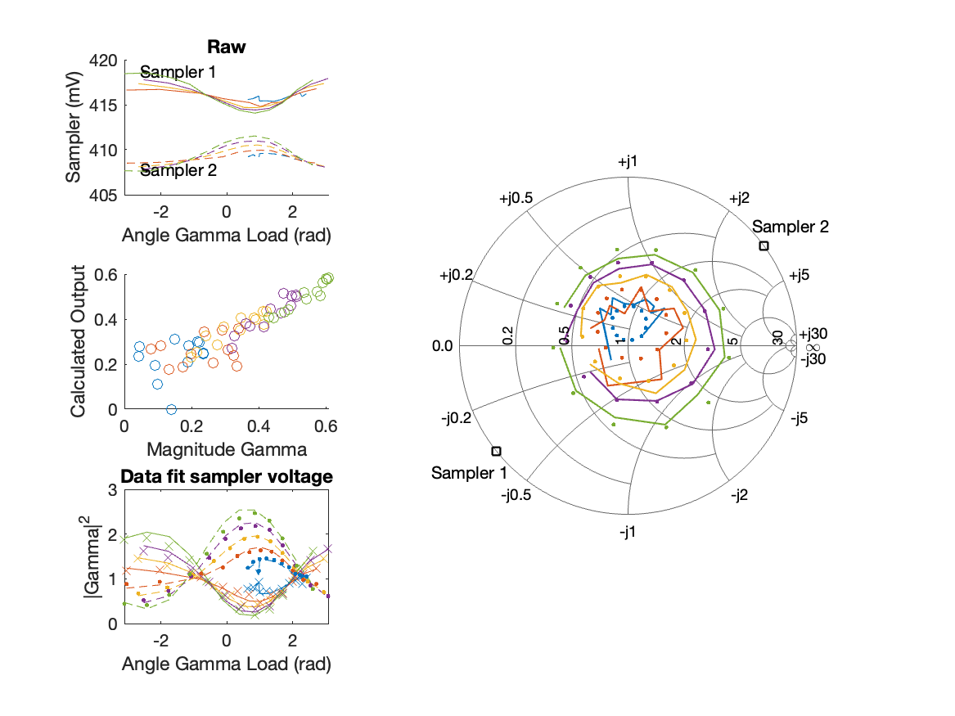
Sampler Performance x^3 Frequency 11.20 GHz, Power 6 dBm
Sampler Av
Sampler 1: 2.404923e+01
Sampler 2: 25.104
Sampler Av3
Sampler 1: 6.856
Sampler 2: 7.780
Sampler Offset (rather than -1)
-75.6558
Goodness Of fit
0.083268

Slide 47
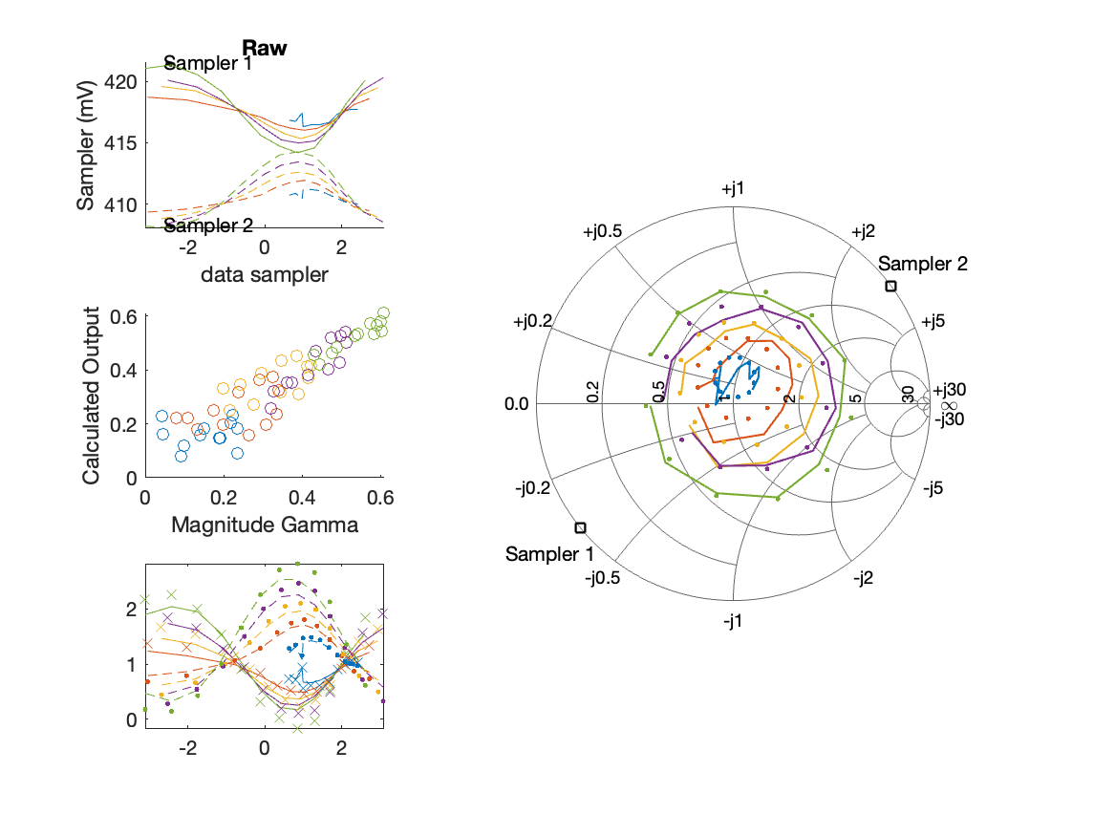
Sampler Performance Frequency 11.20 GHz, Power 8 dBm
Sampler Av
Sampler 1: 169.400
Sampler 2: 217.528
Sampler Offset (rather than -1)
-159.943
Goodness Of fit
0.076954

Slide 48
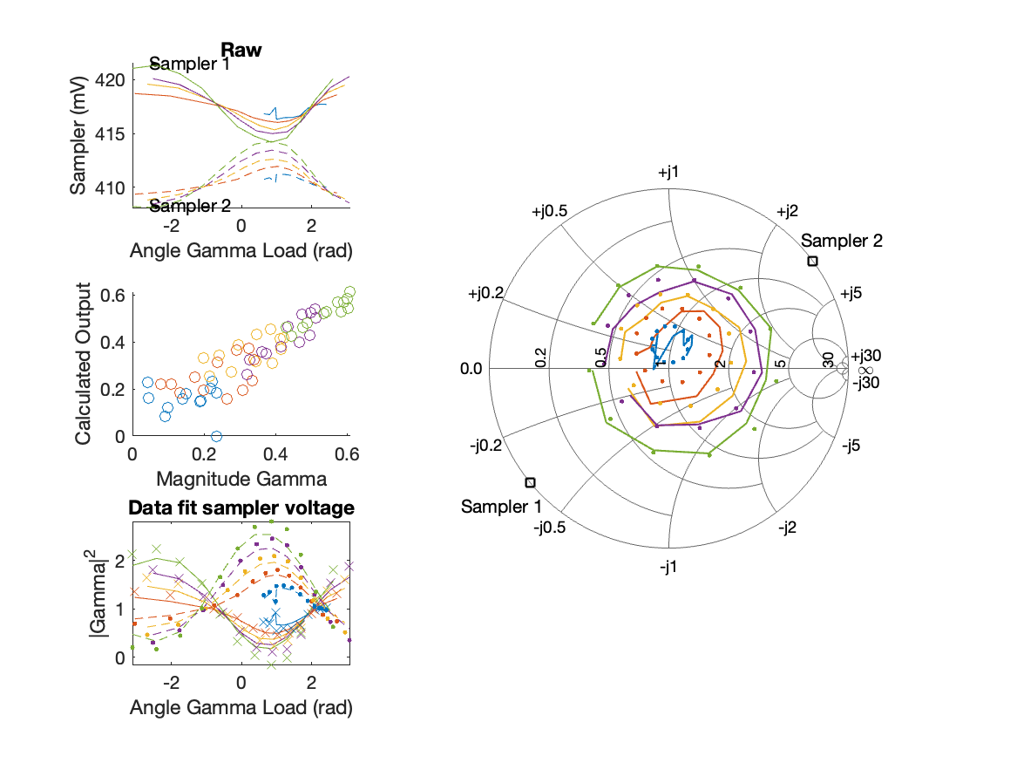
Sampler Performance x^3 Frequency 11.20 GHz, Power 8 dBm
Sampler Av
Sampler 1: 2.482466e+01
Sampler 2: 25.547
Sampler Av3
Sampler 1: 6.471
Sampler 2: 7.197
Sampler Offset (rather than -1)
-66.2782
Goodness Of fit
0.076618

Slide 49
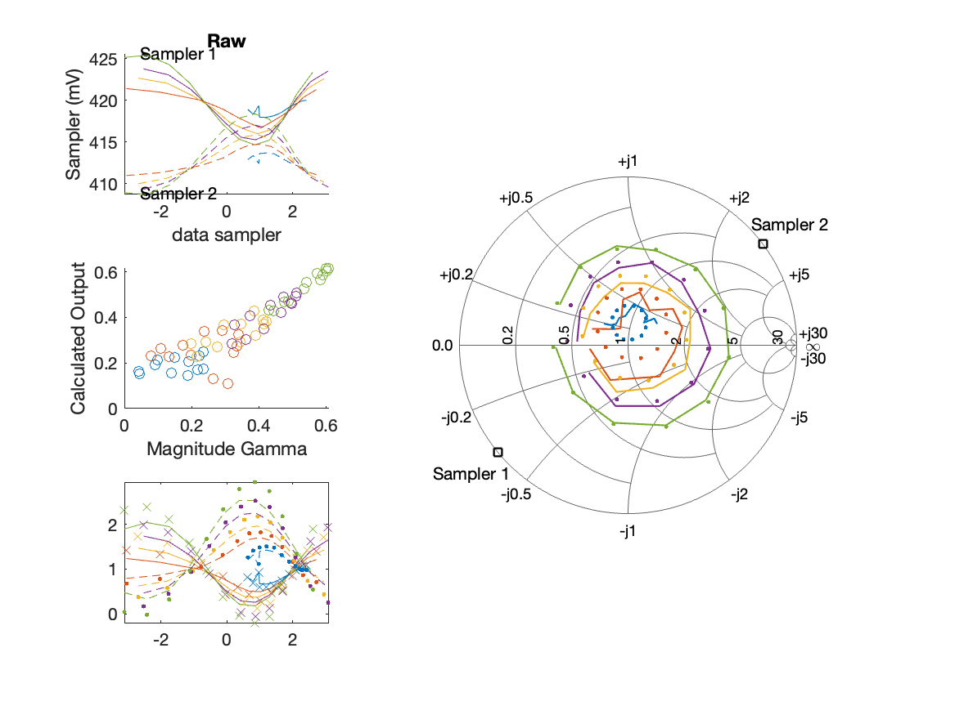
Sampler Performance Frequency 11.20 GHz, Power 10 dBm
Sampler Av
Sampler 1: 120.339
Sampler 2: 153.655
Sampler Offset (rather than -1)
-113.8073
Goodness Of fit
0.057409

Slide 50
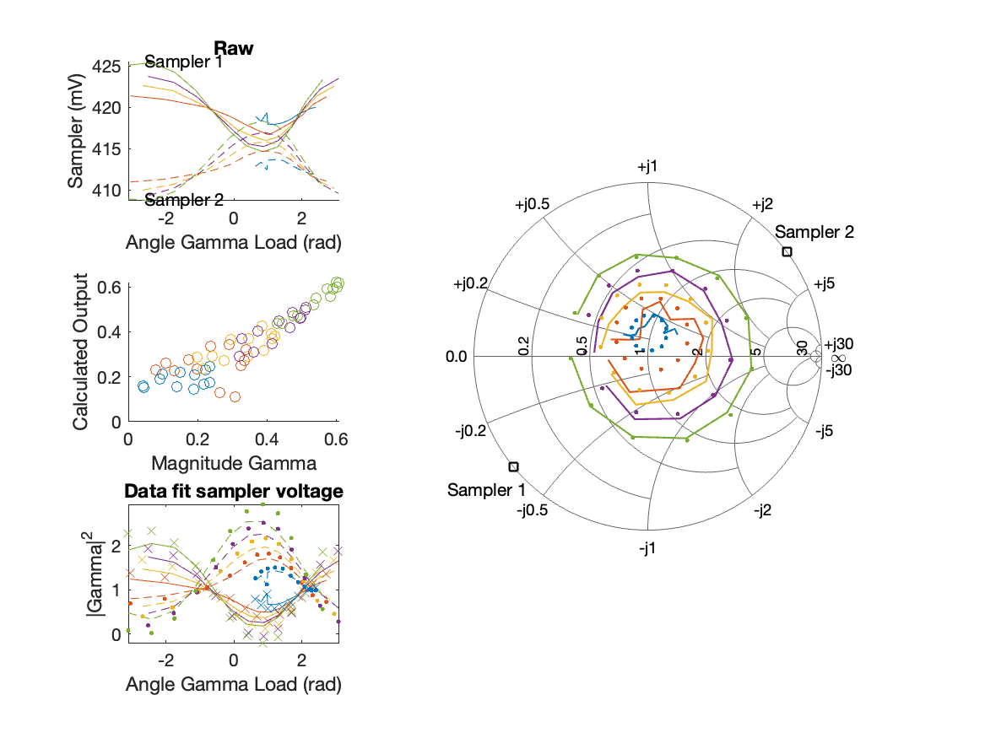
Sampler Performance x^3 Frequency 11.20 GHz, Power 10 dBm
Sampler Av
Sampler 1: 2.548862e+01
Sampler 2: 26.793
Sampler Av3
Sampler 1: 5.586
Sampler 2: 6.228
Sampler Offset (rather than -1)
-51.5065
Goodness Of fit
0.056449

Slide 51
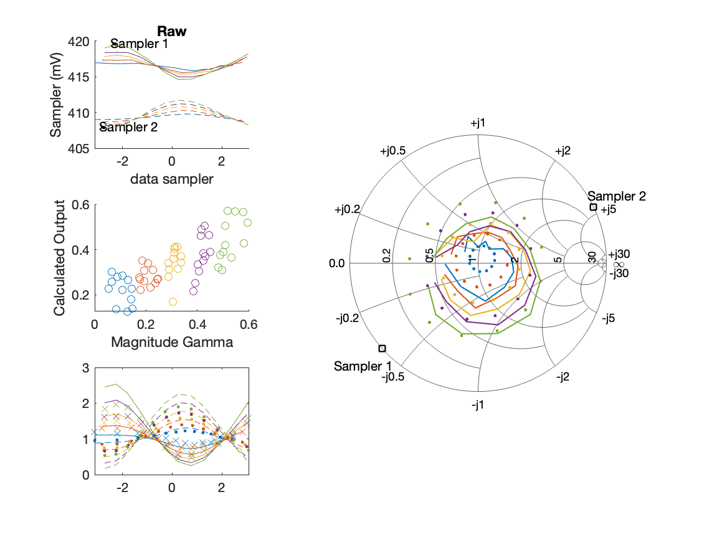
Sampler Performance Frequency 11.30 GHz, Power 6 dBm
Sampler Av
Sampler 1: 155.318
Sampler 2: 174.537
Sampler Offset (rather than -1)
-136.0846
Goodness Of fit
0.24875

Slide 52
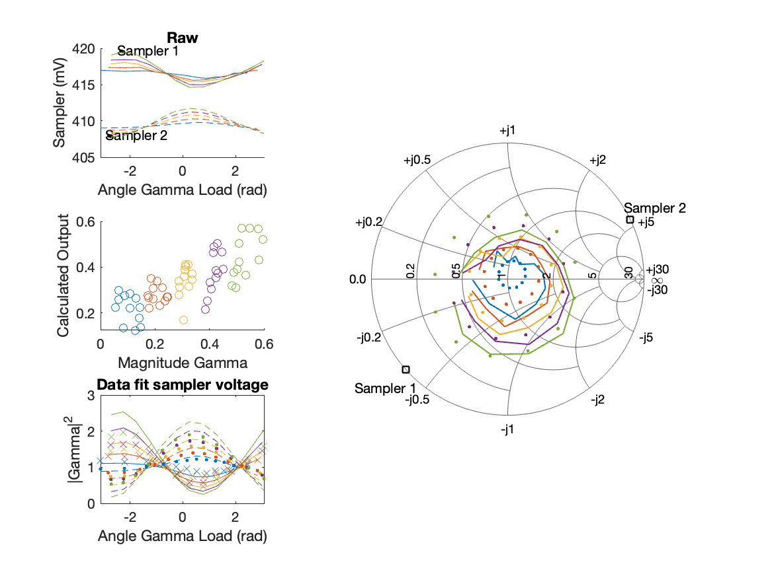
Sampler Performance x^3 Frequency 11.30 GHz, Power 6 dBm
Sampler Av
Sampler 1: 2.279443e+01
Sampler 2: 22.921
Sampler Av3
Sampler 1: 6.337
Sampler 2: 6.704
Sampler Offset (rather than -1)
-57.8784
Goodness Of fit
0.24528

Slide 53
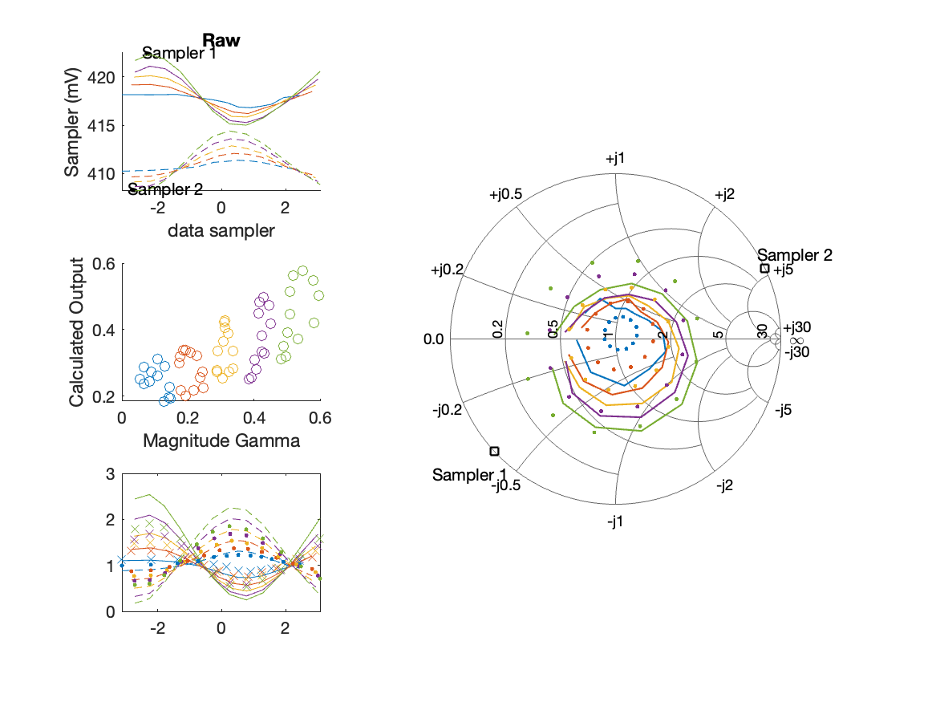
Sampler Performance Frequency 11.30 GHz, Power 8 dBm
Sampler Av
Sampler 1: 94.168
Sampler 2: 102.882
Sampler Offset (rather than -1)
-81.5289
Goodness Of fit
0.26952

Slide 54

Sampler Performance x^3 Frequency 11.30 GHz, Power 8 dBm
Sampler Av
Sampler 1: 2.281000e+01
Sampler 2: 23.662
Sampler Av3
Sampler 1: 5.149
Sampler 2: 5.394
Sampler Offset (rather than -1)
-40.0124
Goodness Of fit
0.26458

Slide 55

Sampler Performance Frequency 11.30 GHz, Power 10 dBm
Sampler Av
Sampler 1: 62.075
Sampler 2: 66.873
Sampler Offset (rather than -1)
-53.5953
Goodness Of fit
0.2671

Slide 56

Sampler Performance x^3 Frequency 11.30 GHz, Power 10 dBm
Sampler Av
Sampler 1: 3.080671e+00
Sampler 2: 3.650
Sampler Av3
Sampler 1: 4.814
Sampler 2: 4.984
Sampler Offset (rather than -1)
-19.6941
Goodness Of fit
0.25724

Slide 57

Sampler Performance Frequency 11.40 GHz, Power 6 dBm
Sampler Av
Sampler 1: 178.285
Sampler 2: 169.201
Sampler Offset (rather than -1)
-143.6921
Goodness Of fit
0.49998

Slide 58

Sampler Performance x^3 Frequency 11.40 GHz, Power 6 dBm
Sampler Av
Sampler 1: 2.615723e+01
Sampler 2: 26.613
Sampler Av3
Sampler 1: 3.613
Sampler 2: 3.665
Sampler Offset (rather than -1)
-28.536
Goodness Of fit
0.53892

Slide 59

Sampler Performance Frequency 11.40 GHz, Power 8 dBm
Sampler Av
Sampler 1: 182.594
Sampler 2: 170.091
Sampler Offset (rather than -1)
-146.2729
Goodness Of fit
0.10491

Slide 60

Sampler Performance x^3 Frequency 11.40 GHz, Power 8 dBm
Sampler Av
Sampler 1: 2.346861e+01
Sampler 2: 21.862
Sampler Av3
Sampler 1: 6.685
Sampler 2: 6.598
Sampler Offset (rather than -1)
-60.594
Goodness Of fit
0.10233

Slide 61

Sampler Performance Frequency 11.40 GHz, Power 10 dBm
Sampler Av
Sampler 1: 119.402
Sampler 2: 110.863
Sampler Offset (rather than -1)
-95.9431
Goodness Of fit
0.0682

Slide 62

Sampler Performance x^3 Frequency 11.40 GHz, Power 10 dBm
Sampler Av
Sampler 1: 2.429906e+01
Sampler 2: 23.243
Sampler Av3
Sampler 1: 5.600
Sampler 2: 5.504
Sampler Offset (rather than -1)
-44.5706
Goodness Of fit
0.065031

